Slide 1
Lighting and Shading
Introduction to Computer Graphics CSE 470 Dianne Hansford, Ph.D.

Slide 2
Objectives
Learn to Light and shade objects so their images appear three-dimensional
Introduce the types of light-material interactions
Build a simple model ---the Phong illumination model--- that can be used with real time graphics hardware

Slide 3
Why we need lighting and shading
Suppose we build a model of a sphere using many polygons and color it with one color. We get something like
But we want

Slide 4
Shading
Why does THIS LOOK LIKE a real sphere?
Light-material interactions cause each point to have a different color or shade
Need to consider
Light sources
Material properties
Location of viewer
Surface orientation (wrt light sources and viewer)

Slide 5
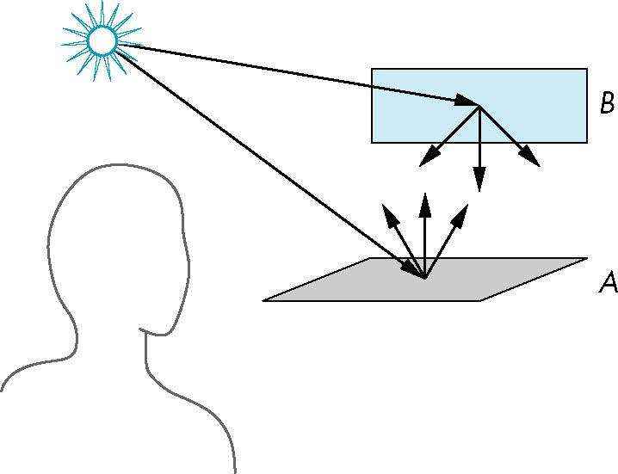
Scattering of Light
Light strikes A
Some scattered
Some absorbed
Some of scattered light strikes B
Some scattered
Some absorbed
Some of this scattered light strikes A
and so on

Slide 6
The Rendering Equation
The infinite scattering and absorption of light can be described by the rendering equation
Rendering equation is global and includes
Shadows
Multiple scattering from object to object
Rendering Equation cannot be solved in general
We must create mathematical models to simulate parts of the rendering equation
Ray tracing is a special case (Model) for perfectly reflecting surfaces

Slide 7
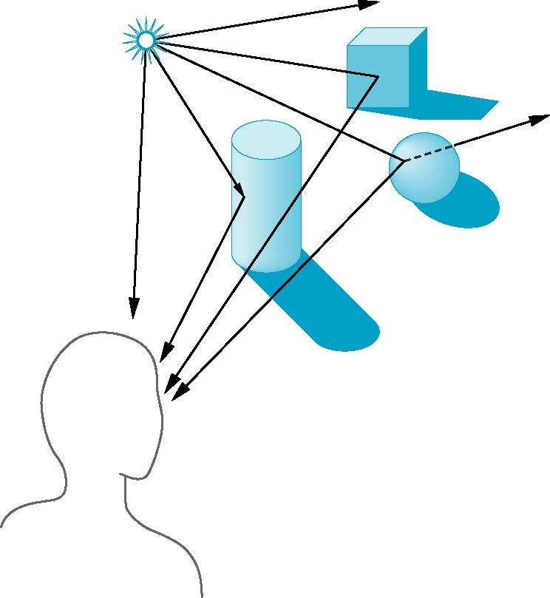
Global Effects of Lighting
shadow
multiple reflection
translucent surface

Slide 8

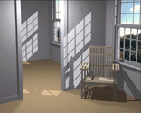
CG Lighting Models
Local Single interaction of light & objects
Phong illumination model
Global Multiple interaction of light & objects raytracing or radiosity

Slide 9
Local vs Global Rendering
Correct shading requires a global calculation involving all objects and light sources
Incompatible with pipeline model which shades each polygon independently (local rendering)
However, in computer graphics, especially real time graphics, we are happy if things “look right”
There exists many techniques for approximating global effects

Slide 10
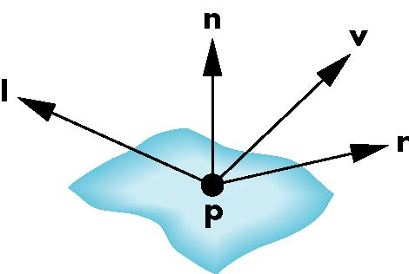
Phong Model
A simple model that can be computed rapidly
Has three light property components
Diffuse
Specular
Ambient
Uses four vectors
To source (l)
To viewer (v)
Normal (n)
Perfect reflector (r)

Slide 11
Light -- Material Interaction
Light that strikes an object is partially absorbed and partially scattered (reflected)
The amount of reflected light determines the color and brightness of the object
Example: A surface appears red under white light because the red component of the light is reflected and the rest is absorbed
The reflected light is scattered in a manner that depends on the smoothness and orientation of the surface
Normal vector orientation

Slide 12
Light Source Properties
ambient light scattered, no detectable direction backlighting in a room
diffuse light directional, scatters once hits object, closest to the color of light
specular light directed and bounces off object in preferred direction plays a role in shininess

Slide 13
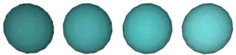

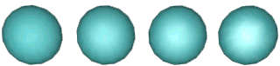
Light Source Properties Examples
increasing diffuse
increasing ambient
increasing specular

Slide 14
Light Sources in Phong Model
Add the results from each light source
Each light source has separate diffuse, specular, and ambient terms
Allows for maximum flexibility even though this form does not have a physical justification
Separate red, green and blue components
9 coefficients for each point source
I_{dr}, I_{dg}, I_{db}, I_{sr}, I_{sg}, I_{sb}, I_{ar}, I_{ag}, I_{ab} diffuse specular ambient I_{d} I_{S} I_{A} _{(Store in 3 vectors)}

Slide 15
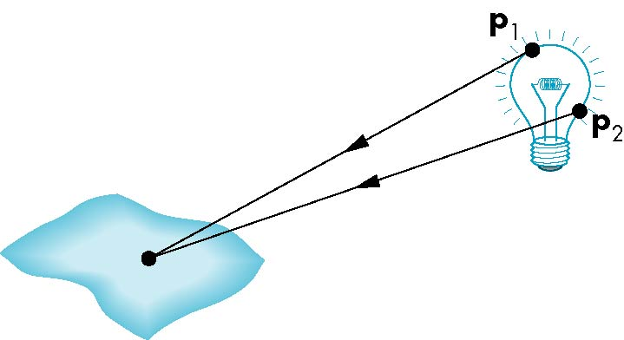
Light Sources
General light sources are difficult to work with because we must integrate light coming from all points on the source

Slide 16
Simple Light Sources
Point source
Model with position and color
Distant source = infinite distance away (parallel)
Spotlight
Restrict light from ideal point source
Think cone-shaped desk lamp
Ambient light
Same amount of light everywhere in scene
Can model contribution of many sources and reflecting surfaces

Slide 17

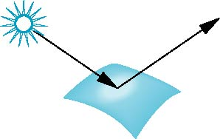
Surface Types
The smoother a surface, the more it behaves as a perfect mirror
reflected light is concentrated in one direction
A very rough surface scatters light in all directions
look around you. do you see surfaces with a variety of reflectance properties?
smooth surface
rough surface

Slide 18
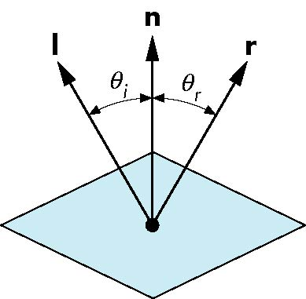
Ideal Reflector
Surface normal is determined by local orientation of surface
Angle of incidence = angle of reflection
The three vectors must be coplanar
Given l, n
Calculate r
r = 2 (l · n ) n - l

Slide 19
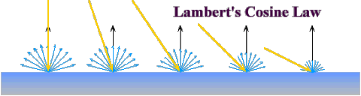
Diffuse Intensity Calculation
Lambert’s Law:
the light reflected is proportional to the cosine of the angle (theta) between surface normal n and light vector l
theta is called the angle of incidence
-- Light scattered equally in all directions
-- Material coefficients k_{r}, k_{b}, k_{g} determine how much of each color
component is reflected

Slide 20

Specular Surfaces
Most surfaces are neither ideal diffusers nor ideal reflectors (perfectly specular)
Smooth surfaces show specular highlights due to incoming light being reflected in directions concentrated close to the direction of a perfect reflection
specular
highlight

Slide 21
Material Properties
Material properties match light source properties
ambient reflectance amount of ambient light most visible where no direct light hits
diffuse reflectance degree of scattering of light on surface matte vs flat paint finish
specular reflectance degree of mirror-like quality
Nine absorption coefficients
k_{dr}, k_{dg}, k_{db}, k_{sr}, k_{sg}, k_{sb}, k_{ar}, k_{ag}, k_{ab} diffuse specular ambient k_{d} k_{S} k_{A} _{(stored as vectors)}
Shininess coefficient: alpha

Slide 22
Modeling Specular Relections
Phong proposed using a term that dropped off as the angle between the viewer and the ideal reflection increased
calculation done independently for red, green, blue, alpha (not a dot product)
I_{r} ~ k_{s} I_{s} cos^{α}φ
φ
reflected
intensity
shininess coeff
incoming specular intensity
material specular reflection

Slide 23
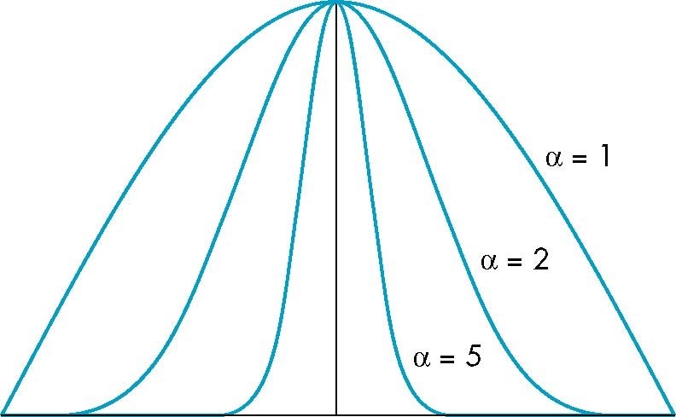
The Shininess Coefficient
Values of alpha between 100 and 200 correspond to metals
Values between 5 and 10 give surface that look like plastic
cos^{α} φ
-90
φ
90

Slide 24
Ambient Light
Ambient light is the result of multiple interactions between light sources and the objects in the environment
Amount and color depend on both the color of the light(s) and the material properties of the object
Add k_{a} I_{a} to diffuse and specular terms

Slide 25
Distance Terms
Light from a point source that reaches a surface is inversely proportional to the square of the distance d between them
Inverse quadratic factor 1/(a + bd +cd²)
to diffuse and specular terms (try plotting 1/d^2)
The constant and linear terms soften the effect of the point source

Slide 26
Light & Material Properties Examples
increasing diffuse
increasing ambient
increasing specular

Slide 27
Light & Material Properties
absorption/reflectance influence on color
Example:
red ball will reflect red light
absorb green and blue light
white light illuminating a red ball → red ball
green light illuminating a red ball → black ball

Slide 28
Phong Model Equation
I = e + k_{a} I_{a}
+ for each light( k_{d} I_{d} l · n + k_{s} I_{s} (v · r )^{α} )
For each color component add contributions from all sources
-- use max{ l.n, 0 }
-- no diffuse, then no specular
-- e emission at vertex (optional)

Slide 29
Modified Phong Model
The specular term in the Phong model is costly because it requires the calculation of a new reflection vector for each vertex
Jim Blinn suggested an approximation using the halfway vector that is more efficient

Slide 30
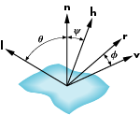
The Halfway Vector “h”
h is a normalized vector halfway between l and v
h = ( l + v ) / || l + v ||

Slide 31
Using the halfway vector
Replace (v · r )^{α} by (n · h )^{β}
β is chosen to match shininess
Note that halfway angle is half of angle between r and v if vectors are coplanar
Resulting model is known as the modified Phong or Phong-Blinn lighting model
Specified in OpenGL standard

Slide 32
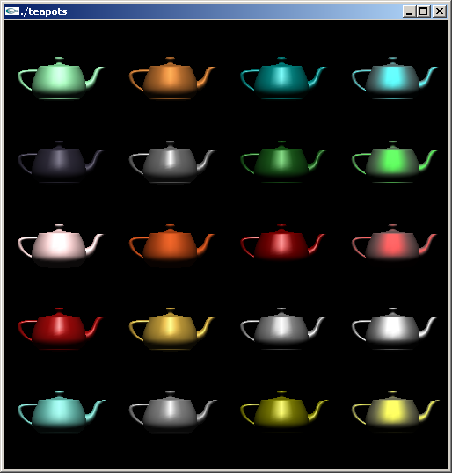
Examples of teapots rendered with the Phong model
Column 1: emerald, jade, obsidian, pearl, ruby, turquoise Column 2: brass, bronze, chrome, copper, gold, silver Column 3: ... Column 4: ...

Slide 33
Phong Input
;
See this link for parameters for each teapot
void renderTeapot(GLfloat x, GLfloat y, GLfloat ambr, GLfloat ambg, GLfloat ambb, GLfloat difr, GLfloat difg, GLfloat difb, GLfloat specr, GLfloat specg, GLfloat specb, GLfloat shine)
Example: top/left emerald renderTeapot(2.0, 17.0, 0.0215, 0.1745, 0.0215, 0.07568, 0.61424, 0.07568, 0.633, 0.727811, 0.633, 0.6);

Slide 34
More on Materials
https://learnopengl.com/Lighting/Materials

Slide 35
Computation of Vectors
3D Object definition determines -- points on the object p -- surface normal n at p
l and v are specified by the application/input
light postion
viewer (eye) position
Compute r from l and n

Slide 36
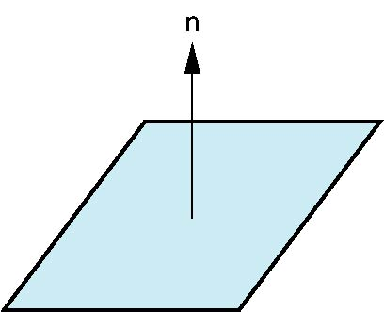
Plane Normals
A plane is determined by
three points p₀, p₁, p₂ (vertices of a triangle!)
or a normal n and point p₀
Normal can be obtained by
n = (p₂ - p₀) × (p₁ - p₀) / || . ||
conventions: -- normals are unit length
-- indicate outward facing side

Slide 37
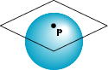
Surface Normals for Parametric Surfaces
Example: a sphere
Tangent plane determined by vectors
Normal given by cross product
x=x(u,v)=cos u sin v Domain:
y=y(u,v)=cos u cos v 0 <= u <= 2Pi
z= z(u,v)=sin u 0 <= v <= Pi
∂p/∂u = [∂x/∂u, ∂y/∂u, ∂z/∂u]^T
∂p/∂v = [∂x/∂v, ∂y/∂v, ∂z/∂v]^T
n = (∂p/∂u × ∂p/∂v) / ||.||

Slide 38
Next Step
Phong lighting model provides an algorithm to calculate a color at one point
This could be a vertex of a triangle mesh
How to color across primitives / surfaces ?
That’s called “shading”

Slide 39
Polygon Shading
Per vertex shading (lighting)
Lighting calculations are done for each vertex
Standard approach: send lighting model parameters to the vertex shader and compute color of vertex there
Default: color interpolated across a primitive Recall: color passed to the fragment shader as a varying variable → smooth shading (Gouraud shading)
Another possibility: use uniform variables to shade with a single shade → flat shading

Slide 40
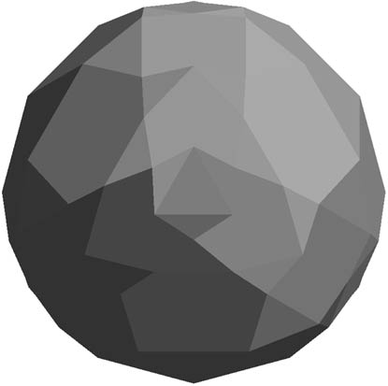
Polygon Mesh Normals
Triangles have a single normal
If we use this normal for each of the vertices of a triangle, we will get this (almost) flat shaded sphere
Phong model producing nearly same color at each vertex
We can do better than this

Slide 41
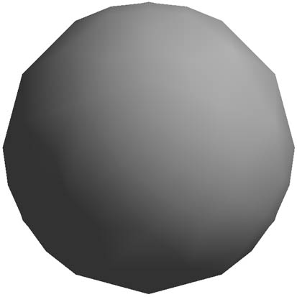
Polygonal Mesh Normals II
Define a normal at each vertex
Parametric surfaces:
Must know (u,v) for each vertex
Mesh with no underlying parametrization
Approximate normals using neighbor information
Silhouette edge

Slide 42
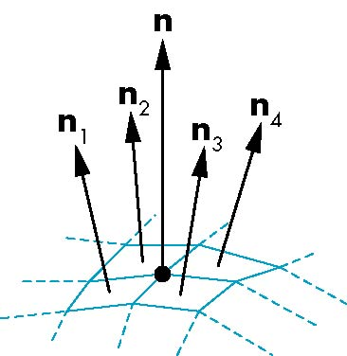
Mesh Shading
For polygonal models, Gouraud proposed using the average of the normals around a mesh vertex
Variation: weight normals based on area
This is why smooth shading is also called Gouraud shading
n = (n₁+n₂+n₃+n₄)/ |n₁+n₂+n₃+n₄|

Slide 43
Gouraud and Phong Shading
Gouraud Shading (vertex shading)
Find average normal at each vertex (vertex normals)
Apply Phong model at each vertex
Interpolate vertex shades across each polygon
Phong Shading (fragment shading)
Find vertex normals
Interpolate vertex normals across edges
Interpolate edge normals across polygon
Apply Phong model at each fragment

Slide 44

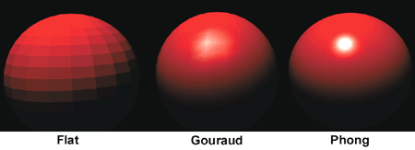
Comparison
Gouraud shading results very dependent on mesh approximation of underlying surface
may show edges if highly curved
In this case, Phong might result in better quality rendering
Phong shading requires much more computation than Gouraud shading
Until recently not available in real time systems
Now can be done using fragment shaders
Both need data structures to represent meshes so we can obtain vertex normals
source: yourdictionary.com

Slide 45
Lighting and Shading in WebGL
Introduction to Computer Graphics CSE 470 Dianne Hansford, Ph.D.

Slide 46
Objectives
Introduce the WebGL shading methods
Light and material functions in MV.js
per vertex vs per fragment shading
Where to implement

Slide 47
Phong Lighting Model
I = k_{d} I_{d} (l · n) + k_{s} I_{s} (v · r )ª + k_{a} I_{a}
Input:
Eye location V = (EYE – P)
Normal at each vertex N
Material properties K*
Lights (location, color, etc.) L = location – P “Color” I*
Compute and/or define these things in application or in shaders

Slide 48
Recall Details
Cosine terms in lighting calculations should be computed using dot product
This requires vectors to be normalized
Be aware that vector length can be affected by transformations
Non-uniform scaling does not preserve length
“Normal Matrix”

Slide 49
Normal for Triangle
n = (p₁ - p₀ ) x (p₂ - p₀ )
n
p₂
normalize n ← n/ |n|
p
p₁
p₀
Note that right-hand rule determines outward face
MV.js has normalize function with flag for 3D/4D vector
GLSL has normalize function too
See demo codes

Slide 50
Specifying a Point Light Source
For each light source
set an RGBA for the diffuse, specular, and ambient components
Set the position
Example for light #0
var diffuse0 = vec4(1.0, 0.0, 0.0, 1.0);
var ambient0 = vec4(1.0, 0.0, 0.0, 1.0);
var specular0 = vec4(1.0, 0.0, 0.0, 1.0);
var light0_pos = vec4(1.0, 2.0, 3,0, 1.0);

Slide 51
Light Distance and Direction
The light source colors are specified in RGBA
The position is given in homogeneous coordinates
If w =1.0, we are specifying a finite location
If w =0.0, we are specifying a parallel source with the given direction vector
Can specify a, b, c for quadratic distance function (1/(a + b*d + c*d^2)) where d is the distance from the point being rendered to the light source

Slide 52
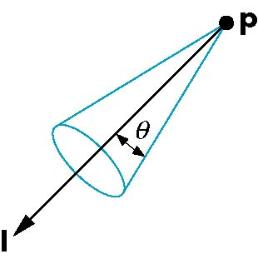
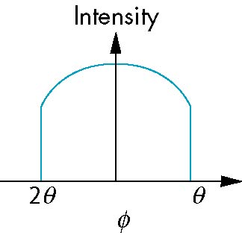
Spotlights
Derive from point source
Direction
Cutoff
Attenuation Proportional to cos^{α}φ
−θ
φ
θ

Slide 53
Global Ambient Light
Ambient light depends on color of light sources
Example: A red light in a white room will cause a red ambient term that disappears when the light is turned off
A global ambient term that is often helpful for testing

Slide 54
Moving Light Sources
Light sources are geometric objects whose positions or directions can be affected by the model-view matrix
We can
Move the light source(s) with the object(s)
Fix the object(s) and move the light source(s)
Fix the light source(s) and move the object(s)
Move the light source(s) and object(s) independently

Slide 55
Material Properties
Material properties should match the terms in the light model
Represent reflective properties
w component gives opacity (sort of – more later)
var materialAmbient = vec4( 1.0, 0.0, 1.0, 1.0 );
var materialDiffuse = vec4( 1.0, 0.8, 0.0, 1.0);
var materialSpecular = vec4( 1.0, 0.8, 0.0, 1.0 );
var materialShininess = 100.0;

Slide 56
Using MV.js for Products
var ambientProduct = mult(lightAmbient, materialAmbient);
var diffuseProduct = mult(lightDiffuse, materialDiffuse);
var specularProduct = mult(lightSpecular, materialSpecular);
gl.uniform4fv(gl.getUniformLocation(program,"ambientProduct"),flatten(ambientProduct));
gl.uniform4fv(gl.getUniformLocation(program,"diffuseProduct"),flatten(diffuseProduct) );
gl.uniform4fv(gl.getUniformLocation(program,"specularProduct"),flatten(specularProduct) );
gl.uniform4fv(gl.getUniformLocation(program,"lightPosition"),flatten(lightPosition) );
gl.uniform1f(gl.getUniformLocation(program,"shininess"),materialShininess);
This could be a variable (as we have been doing it)

Slide 57
Adding Normals for Quads
function quad(a, b, c, d) {
var t1 = subtract(vertices[b], vertices[a]);
var t2 = subtract(vertices[c], vertices[b]);
var normal = cross(t1, t2);
var normal = vec3(normal);
normal = normalize(normal);
pointsArray.push(vertices[a]);
normalsArray.push(normal);
.
.
.

Slide 58

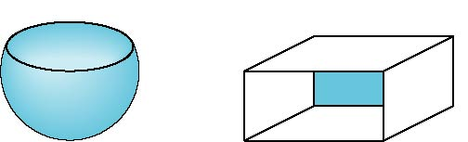
Front and Back Faces
Every face has a front and back
For many objects, we never see the back face
so we don’t care how or if it’s rendered
If it matters, we can handle in shader
back faces not visible
back faces visible

Slide 59
Emissive Term
We can simulate a light source in WebGL by giving a material an emissive component
This component is unaffected by any sources or transformations

Slide 60
Transparency
Material properties are specified as RGBA values
The A value can be used to make the surface translucent
The default is that all surfaces are opaque
Later we will enable blending and use this feature
However with the HTML5 canvas, A<1 will mute colors

Slide 61
Demos
wireSphere: wire frame of recursively generated sphere
shadedCube: rotating cube with modified Phong shading
shadedSphere1: shaded sphere using true normals and per vertex shading
shadedSphere2: shaded sphere using true normals and per fragment shading
shadedSphere3: shaded sphere using vertex normals and per vertex Shading
shadingshadedSphere4: shaded sphere using vertex normals and per fragment shading

Slide 62
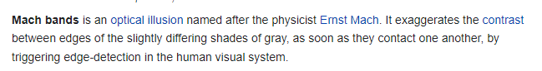
Mach Bands

Slide 63
3D Data Generation for CG
Introduction to Computer Graphics
CSE 470
Arizona State University
Dianne Hansford, Ph.D.

Slide 64
Primary CG Applications
Engineering
CAD/CAM
Animation
advertising & feature films
Games
Visualization
What are the 3d data needs of each application?

Slide 65
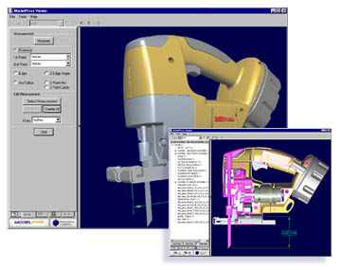
Engineering
CAD/CAM := computer-aided design & manufacture
Precision of design
Analysis methods
Manufacturable
Hierarchical
From www.modelpress.com

Slide 66
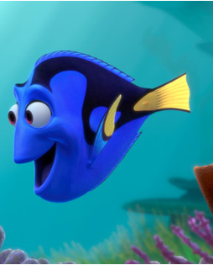
Animation: feature films
Cartoon .vs. realism
Optimize rendering time
Easily animated
Highly textured
Finding Nemo from Pixar www.pixar.com

Slide 67
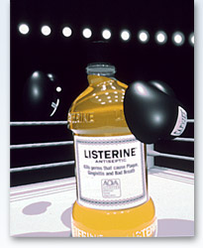
Animation: advertising
Similar to films
CAD design often available
Listerine animated ad from Pixar www.pixar.com

Slide 68
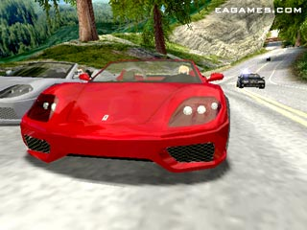
Games
Low polygon count
Highly textured
Cartoon .vs. realism
Easily animated
Need for Speed from Electronic Arts www.ea.com

Slide 69
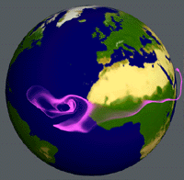
Visualization
Representation and interpretation of measured data
Earth winds from LLNL www.llnl.gov/graphics

Slide 70
Creating 3D Data
1. Modeling system
CAD/CAM
Entertainment
2. Digitize an object
Tool sets differentiate packages

Slide 71



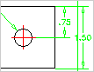
CAD Modeling System
Many times: 2D plans basis of 3D models
Parametric curves and surfaces: Bézier, NURBS
Engineer’s toolset
www.autodesk.com www.ptc.com www.dassault.com

Slide 72


Entertainment Modeling System
Combines many data creation techniques
polygons
NURBS
subdivision surfaces
Artist’s toolset
Animation tools
3ds max
Maya
www.discreet.com www.alias.com

Slide 73


Digitizing
Scanners: non-tactile (laser)
tactile
Part of process called reverse engineering
www.cyberware.com www.immersion.com

Slide 74
Reverse Engineering Process
Scan and Triangulate
Registration of data
Clean-up data
Decimate
Modeling system
→ archival data

Slide 75
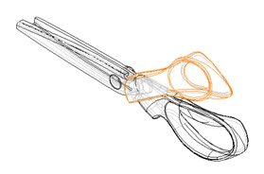
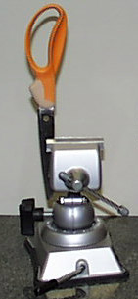
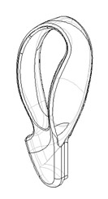
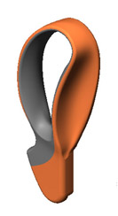
www.immersion.com

Slide 76
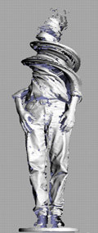
Reverse Engineering
becoming an artist’s tool
PRISM @ ASU Partnership for Research in Spatial Modeling
Art Dept. -- Dan Collins
http://prism.asu.edu

Slide 77
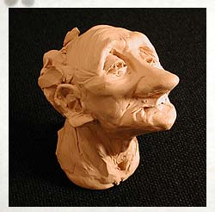
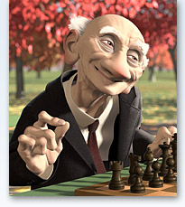
Pixar Case Study: Characters
Character development: reverse engineering clay model → digitize → modeling system
From Geri’s game www.pixar.com

Slide 78
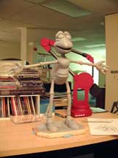
Tactile digitizing:
Labor intensive
but
Can make transition
to modeling system
easier

Slide 79
Pixar Case Study: Modeling
In-house modeling tools
’95 Toy Story parametric surfaces
’97 Geri’s Game subdivision surfaces
’98 A Bug’s Life subdivision surfaces
...
Found animation tools difficult to create
Experimented with subdivision surfaces on this short film
Major hurdle: textures
Parametric surfaces used at Pacific Data/now Dreamworks (Antz, Shrek)

Slide 80
3D Models
Models sold & free
www.turbosquid.com
www.3dcafe.com
Many file formats available
Just about any object

Slide 81
Cel Shading
Jason McCollum

Slide 82
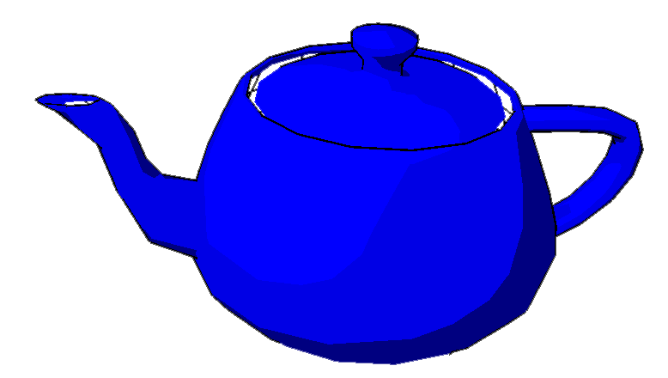
Overview
Nonphotorealistic Rendering (NPR)
Cel-shading Concepts

Slide 83
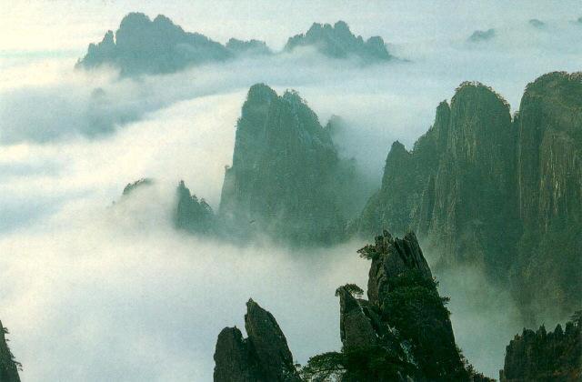
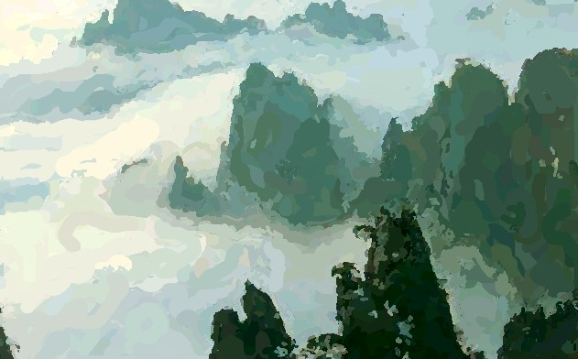
Why NPR?
Original:
Expression
Communication
Emotion
Mood
Flexibility
Change styles simply by changing rendering method.
NPR:
Image source: NYU Media Research LAB, http://mrl.nyu.edu/projects/npr/painterly/

Slide 84
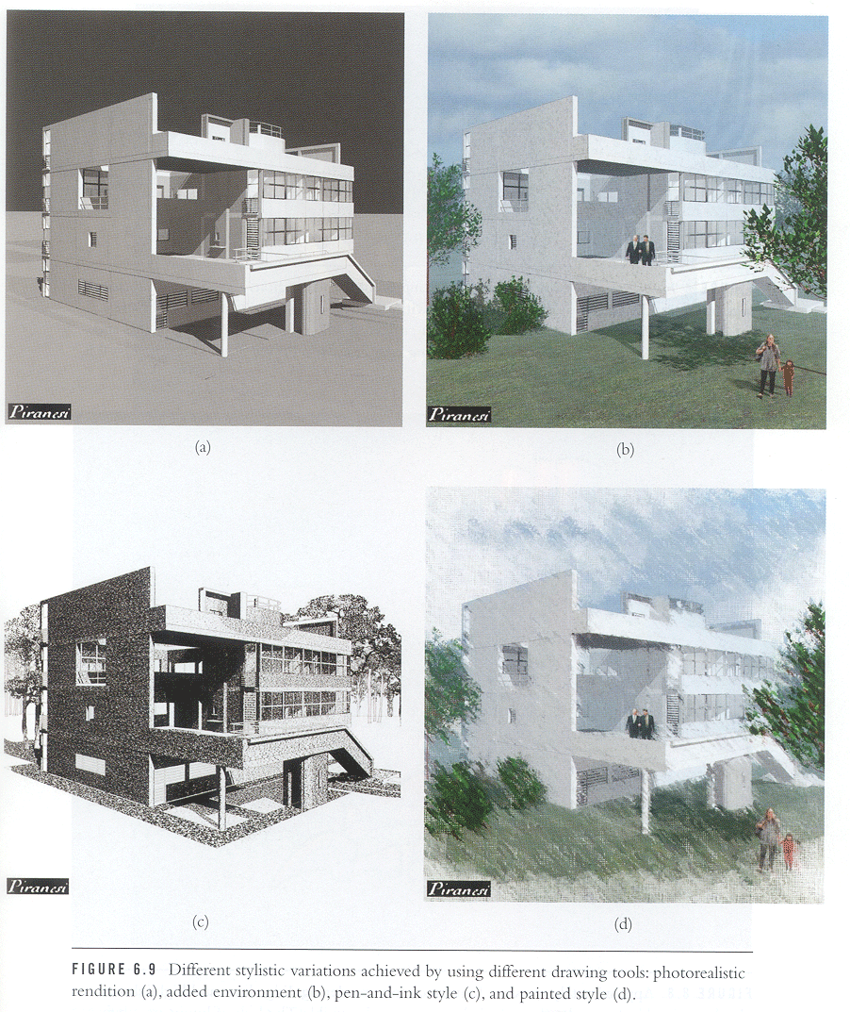
Example:
Each rendering has a different “feel”.
Bottom 2 images would most likely be presented to customer as concept art.
Top 2 images would most likely be presented to a customer as the final design.
Image source: [Strothotte T., Schlechtweg, S. 2002]

Slide 85
Cel Shading
Also called Cartoon Shading, or Hard Shading.
Named after the process of inking and coloring cels (clear plastic sheets) in hand-drawn animation.
3D objects look like a 2D cartoon.
Two steps: Shading, Outline Drawing

Slide 86
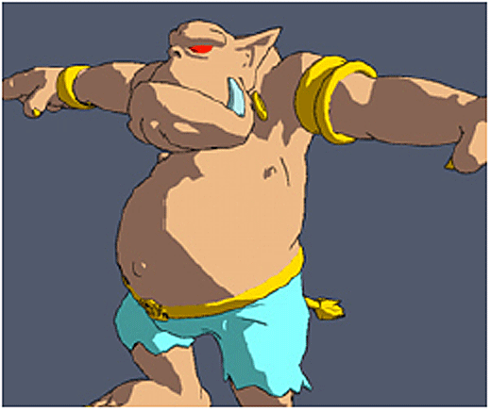
Cel-Shading Example
Image source: Intel Corporation, http://www.intel.com/labs/media/3dsoftware/nonphoto.htm

Slide 87
Shading
1D Textures – a 1xn texture.
Texture Coordinate:
0 0.5 1
Consider this texture:
Texture Coordinate:
0 0.5 1

Slide 88
Choosing Texture Coordinate
Use light equation to pick a texture coordinate.
Recall the lighting model:
eye
l
n
θ

Slide 89
Choosing Texture Coordinate
LIGHT COSθ TEXTURE
l
l
l
1
l
n
0 .5 1
l
0
0˚
90˚

Slide 90
Outlining
When is an edge part of the object outline?
Border – The edge is not shared.
Silhouette – An edge is shared between a front-facing and back-facing polygon.
Hard edges – An edge shared by polygons that meet within some angle threshold (0° through 180°).
Border Silhouette Hard Edges

Slide 91
Algorithms
Software: (after drawing shading)
Build an edge list. for each edge in edge list if edge not shared then draw edge. if edge belongs to front-facing and back-facing polygon then draw edge if edge belongs to two front-facing polygons that meet within some threshold then draw edge
Hardware: (after drawing shading)
Use Z-Buffer and hardware support for drawing front-facing or back-facing polygons.

Slide 92
Using the OpenGL pipeline
Set Z-Buffer comparison to less than or equal. ::glDepthFunc(GL_LEQUAL)
Tell the hardware to draw only back-facing polygons, and to draw them in wireframe mode. ::glCullFace(GL_FRONT) ::glPolygonMode(GL_BACK, GL_LINE)
Set line width > 1.0 for outlines ::glLineWidth(w)
Draw model.
default is <
not a webgl fcts; recall hat demo

Slide 93
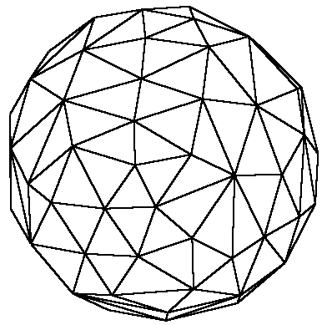
Using the Hardware (continued)
Back faces of wireframe sphere
Final cell-shaded sphere
Shading
+
=
The border comes from the Z-Buffer test. The only edges of the back-facing wireframe that are drawn are the edges that are at the same depth as the shaded front-facing polygons (i.e., silhouette edges).

Slide 94
Trade Offs
Software | Hardware
Have to maintain an edge list. | No additional data structures.
Outline can be drawn in the same rendering pass as the shading. | Outline requires another rendering pass.
Allows borders, outlines, and hard edges. | Draws only silhouettes and certain borders.
More difficult to implement. | Very easy to implement.

Slide 95
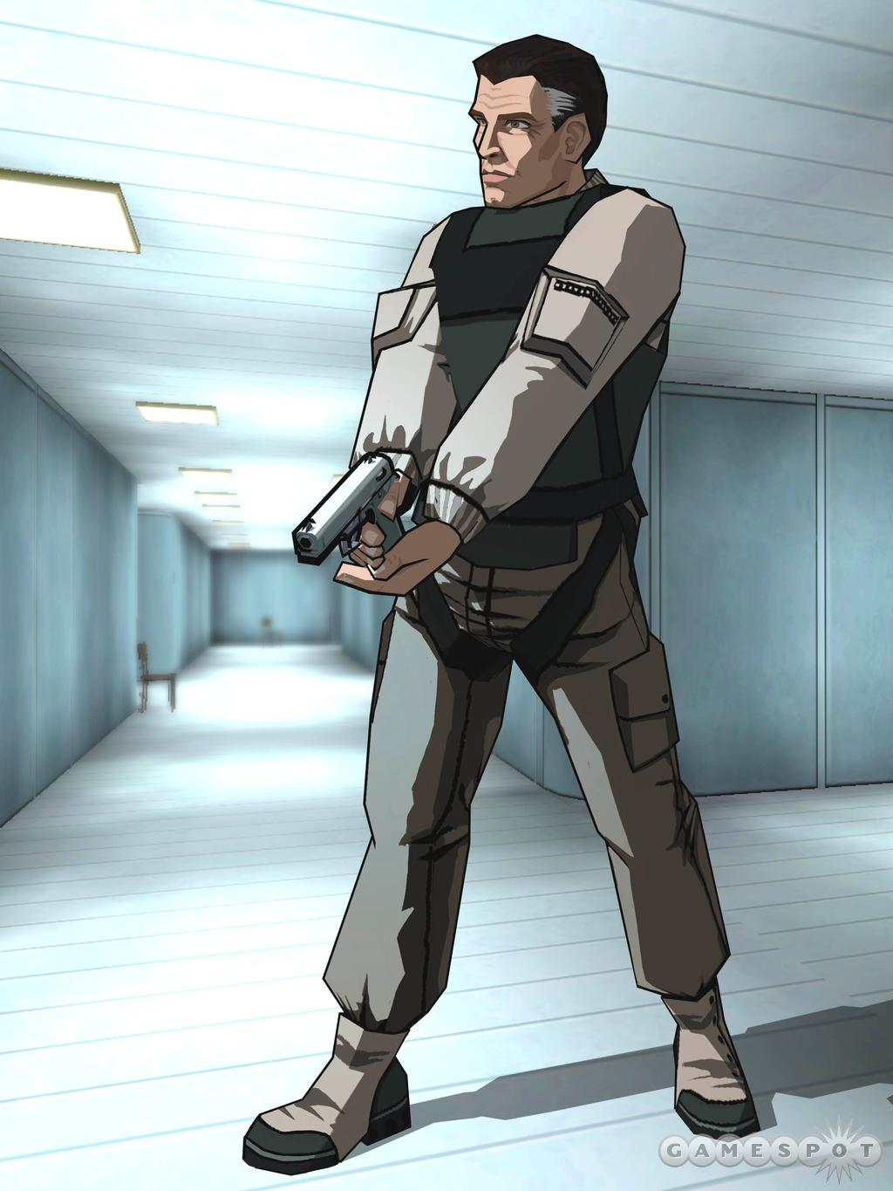

Examples
Left: Screenshot from the game XIII (UbiSoft), an example of real-time cel shading.
Right: Image from Hotaru, a short animation created using a cel-shading plugin (unReal) for Lightwave3D.

Slide 96
Related Resources
NeHe’s cel-shading tutorial: http://nehe.gamedev.net/, lesson 37.
Many resources for cel shading: http://www.celshader.com/links.html
BESM – Freeware (source code available) plugin for Lightwave 3D: http://www.celshaded.com/
Hotaru animation - http://ikkyuu-an.homeip.net/%7Eshishi/hotaru/
XIII game - http://www.whoisxiii.com/community/index.php

Slide 97
Buffers in WebGL
Introduction to Computer Graphics CSE 470 Dianne Hansford, Ph.D.

Slide 98
Objectives
Introduce additional WebGL buffers
Reading and writing buffers
Buffers and Images

Slide 99
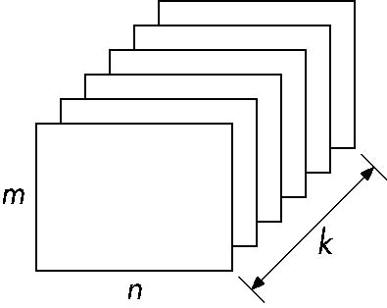
Buffer
Spatial resolution (n x m)
Depth (or precision) k = the number of bits/pixel
pixel (all k bits)
bitplane = one of k planes)

Slide 100
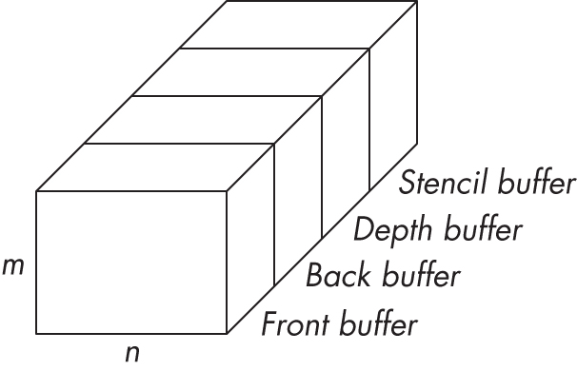
(WebGL) Framebuffer
Set of buffers that the graphics system uses for rendering
portion of RAM containing a bitmap
Can also refer to other (off-screen) buffers

Slide 101
Where are the Buffers?
On the graphics card
Front and back color buffers
HTML5 Canvas
Under control of local window system
Most RGBA buffers are 8 bits per component 8 x 4 = 32 bits
Depth buffer
Normally 24 bit
Stencil buffer
Holds masks
Normally 8 bit
Latest are floating point (IEEE)

Slide 102
More on the Framebuffer
Generally treated as a black box
Application programmer does not need to deal with details
Can color individual pixels thru fragment shader, but no need to know details of framebuffer storage
WebGL allows for read / write of blocks of pixels
BITBLT (bit block transfer)
reading inefficient due to pipeline architecture
want to minimize CPU – GPU transfers
3 types memory involved:
processor memory in CPU
texture memory attached to GPU
memory in the GPU

Slide 103
Images to Framebuffer
Data transferred between processor and graphics memory on the graphics card
Typical transfer: images
jpg, png, tiff, ...
Each has its own format
Data must be reformatted to be compatible with framebuffer format
(Images here refer to arrays of pixels) Details to come with code examples

Slide 104
Image Formats Packing and Unpacking
Compressed or uncompressed
Lossless or lossy
Indexed or RGB
Bit Format
little or big endian (byte order)
WebGL has little support for packing/unpacking
HTML/browser allow access to standard formats
use texture functions
can implement desired functionality in fragment shaders

Slide 105
Buffer Reading
WebGL can read pixels from the framebuffer with gl.readPixels
Returns only 8 bit RGBA values
In general, the format of pixels in the framebuffer is different from that of processor memory and these two types of memory reside in different places
Need packing and unpacking
Reading can be slow

Slide 106
WebGL Pixel Function
gl.readPixels(x,y,width,height,format,type,myimage)
start pixel in frame buffer
size
type of pixels
type of image
pointer to processor
memory
var myimage[512*512*4];
gl.readPixels(0,0, 512, 512, gl.RGBA,
gl.UNSIGNED_BYTE, myimage);

Slide 107
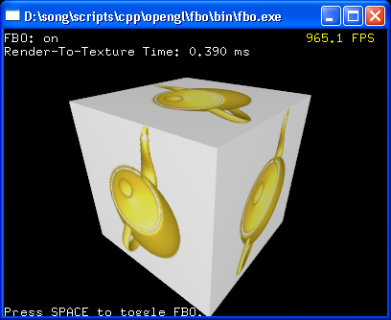
Render to Texture
Render into texture memory instead of the frame buffer and then read from this memory
GPU has large amount of texture memory
Fast – independent of window system
More applications
Image processing
GPGPU (General Purpose GPU)

Slide 108
Texture Mapping
Introduction to Computer Graphics CSE 470 Dianne Hansford, Ph.D.

Slide 109
Objectives
Introduce Mapping Methods
Texture Mapping
Environment Mapping
Bump Mapping
Height Mapping
Fundamentals
How does it work?
How does it fit into the pipeline
(WebGL specifics will come in the next PPT)

Slide 110
Four Types of Mapping
Texture Mapping
Uses images to fill inside of polygons
Create complexity in an image without the overhead of building large geometric models
Environment (reflection mapping)
Uses a picture of the environment for texture maps
Allows simulation of highly specular surfaces
Bump mapping or Normal mapping
Emulates altering normal vectors
Height Maps
Geometry from color maps

Slide 111
The Limits of Geometric Modeling
Although graphics cards can render over 10 million polygons per second, that number is insufficient for many phenomena
Clouds
Grass
Terrain
Skin

Slide 112
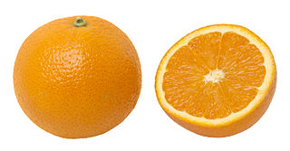
Example: Modeling an Orange
Start with an orange-colored sphere
Too simple
Replace sphere with a more complex shape
Difficult to capture surface characteristics
Takes too many polygons to model all the dimples
Take a picture of a real orange, scan it, and “paste” onto simple geometric model
This process is known as texture mapping
Surface’s interaction with light will be incorrect
Bump mapping helps with this problem

Slide 113
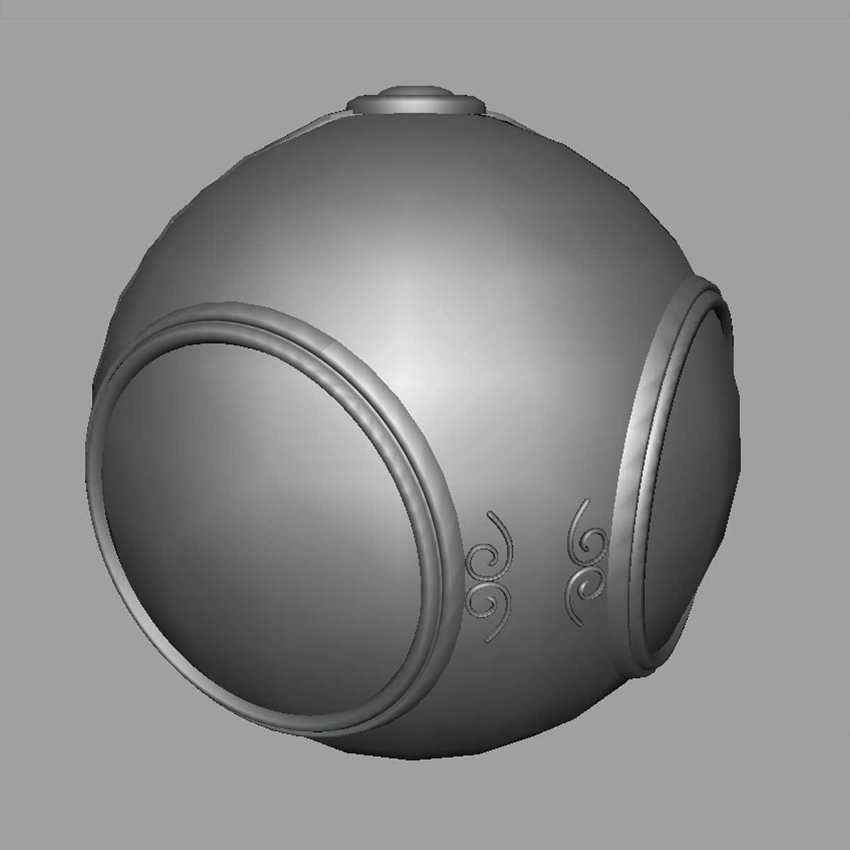
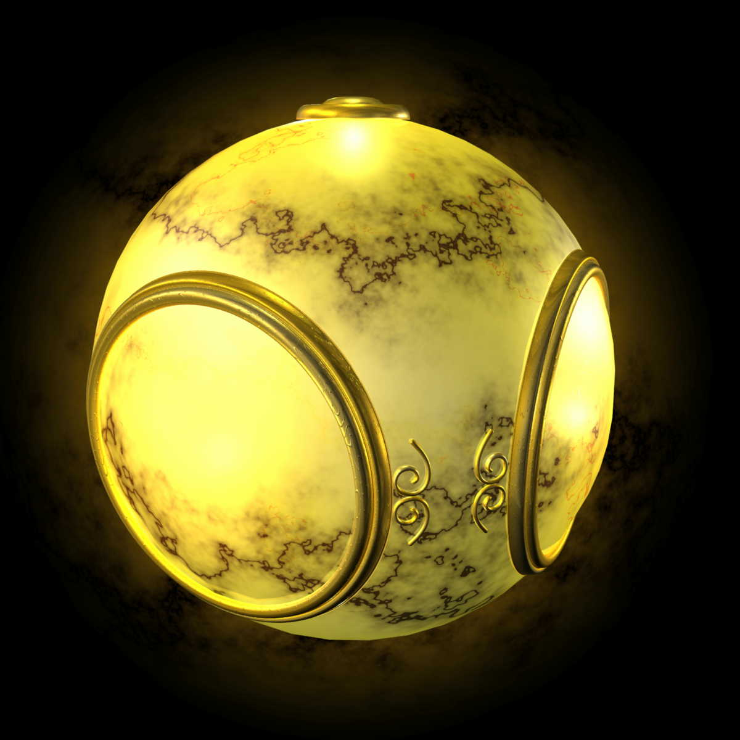
Texture Mapping
geometric model
texture mapped

Slide 114


Texture Mapping Examples
Create complexity without overhead of building large geometric models.

Slide 115

Environment Mapping

Slide 116

Bump Mapping

Slide 117

Height Mapping

Slide 118

Where does mapping take place?
Mapping techniques are implemented at the end of the rendering pipeline
Very efficient because only visible polygons make it past the clipper

Slide 119

Texture Mapping
Although the idea is simple ---map an image to a surface--- there are 3 or 4 coordinate systems involved
Texture: 2D image
m x n array of pixels called texels (texture elements)
3D surface
Textures can also be 1-d or 3-d Do you remember an example of a 1-d texture?

Slide 120
Coordinate Systems
Parametric coordinates
May be used to model curves and surfaces
Texture coordinates
Used to identify points in the image to be mapped
Object or World Coordinates
Conceptually, where the mapping takes place
Window Coordinates
Where the final image is really produced

Slide 121

Texture Mapping Coordinate Systems
parametric coordinates
texture coordinates
window coordinates
texels
world coordinates
pixels

Slide 122
Texture ←→ Surface Mapping
Three common solutions for assigning texture coordinates to points on surface
Surface domain (for parametric surfaces) Very straight forward
Auxiliary surface (Cylinder, Sphere)
Flatten the surface When no parametrization for the surface exists (polygonal mesh) create parametrization by flattening to 2D. Then treat like #1

Slide 123

Texture ←→ Surface Mapping Parametric Surface Domain
Parametric surfaces make assignment easy
However, distortion of texture will occur
Can minimize distortions by preserving aspect ratio of texture and geometry
Two solutions: 1) repeat texture 2) use just a portion of the texture (to match the aspect ratio)
texture
geometry

Slide 124

Texture ← →Surface Mapping Auxiliary Surface Method * Step 1
Map the texture to a simple intermediate surface
Example: map to cylinder

Slide 125
Cylindrical Mapping
parametric cylinder
x = r cos 2π u
y = r sin 2π u
z = vh
Maps rectangle in u,v space [0,1] x [0,1] to cylinder of radius r and height h in world coordinates
s = u
t = v
Maps from texture space

Slide 126
Spherical Map
parametric sphere
x = r cos 2π u
y = r sin 2π u cos 2π v
z = r sin 2π u sin 2π v
Maps rectangle in u,v space [0,1] x [0,1] to sphere of radius r -- This maps a square to a sphere – try this with a piece of paper
-- Have to decide where to put the distortion (north/south poles)
Spheres are used in environmental maps

Slide 127

Cube Mapping
Easy to use with simple orthographic projection
Also used in environment maps

Slide 128

Texture ← →Surface Mapping Auxiliary Surface Method * Step 2
Map from intermediate object to actual object
Normals from intermediate to actual (left)
Normals from actual to intermediate (middle)
Vectors from center of intermediate (right)
intermediate
actual

Slide 129

Texture ← → Surface Mapping Flatten the Surface Method

Slide 130
Texture Mapping Big Picture
Step 1: Establish texture to surface mapping
one of 3 methods (parametric, auxiliary, flatten)
Step 2: Assign texture coordinates to triangle vertices
Creates correspondence (s,t) → (u,v) → Surf(u,v)
Send texture coordinate info to GPU with vertices (s,t) for every (x,y,z)
Assign color to pixel (belonging to a triangle)
Texture coordinates at vertices interpolated over triangle
Interpolation generates (s,t) for pixel
find color in texture map

Slide 131

Texture Coordinates
A texture is usually addressed by values between zero and one
The “addresses” of points on the texture consist of two numbers (s, t)
A 3D vertex is associated with a point on the texture by assigning it texture coordinates
…although it is really just an array of pixels
[0, 1]
t
[1, 0]
[0,0]
s
[s,t]-space → [u,v]-space of surface → [x,y,z]-space of surface

Slide 132
Pixels & Texture Coordinates
[0, 1]
s, t = .33, .33
t
For example: a 4 x 4 pixel image
mychecker[4][4][3];
[1, 0]
[0,0]
s

Slide 133

Texture Coordinates to Polygons
1,0
1,1
Texture Coordinates
0,0
1,0
s, t = .33, .33
Each vertex of each polygon in assigned a texture coordinate.
WebGL finds the appropriate texture coordinate for points “between” vertices during rasterization. – same idea as smooth shading!

Slide 134
Modes of Operation
Decal: only the texture color determines the color we see in the frame buffer
Modulation: texture color multiplied by the computed lighting model color
Blend: Similar to modulation but add alpha-blending

Slide 135
Texture Mapping Issues
What should happen when we zoom in close or zoom out far away?
How do we generate texture coordinates ?
What happens if we use texture coordinates outside [0,1]?
Are texture maps only for putting color on objects?

Slide 136


Aliasing
Point sampling of the texture can lead to aliasing errors
aliasing: distortion caused by sampling
left: aliasing
right: antialiasing (attempt to reduce distortion)
point samples in texture space
miss blue stripes
point samples in u,v space

Slide 137

Area Averaging
Average texels around current (s,t)
pixel
preimage
Surface is curved resulting in non-uniformity of pixel : surface area.
Surface is the preimage of the pixel.

Slide 138
Texture to Surface Mapping
Texture map to surface takes place during rendering Similar to smooth shading method: -- Triangle rasterized -- Each pixel mapped back to the texture -- Use known values at triangle vertices to interpolation over the texture
Each pixel is associated with small region of surface and to a small area of texture. 3 possibilities for texel-pixel association: 1) one texel to one pixel (rare) 2) magnification 3) minification
Magnification one texel to many pixels
Minification many texels to one pixel

Slide 139



Zoom In: Magnification Problem
one texel corresponds to many pixels → “blockiness” / jaggies / aliasing
solution: apply averaging (magnification filter)

Slide 140
Zoom-In: Magnification Filter
Another way to say it: A pixel corresponds to a small portion of one texel
Results in many pixels getting same texel In this example: all 4 pixels get color from one texel
Without a filtering method, aliasing is common
Magnification filter: smooths transition between pixels
pixel
Texture space

Slide 141
Zoom-In: Magnification Filter
Options for smoothing: Simplest: GL_NEAREST Just use the closest texel’s color (default – jaggies common) Also called point sampling
Better: GL_LINEAR Weighted average of the four nearest texels Also called bilinear sampling (interpolation)
Bilinear interpolation:
Get local coords (b1,b2) in [0,1] b1 = (s – s0)/(s2 – s0) b2 = (t – t0)/(t2 – t0)
c = (1-b2) * ( (1-b1)*c0 + b1*c1)
+ b2 * ( (1-b1)*c2 + b1*c3)
c3
c0
c1
(s0, t0)
(s2, t0)

Slide 142
Zoom Out: Minification Filter
Many texels correspond to one pixel
Common with perspective foreshortening (see example on next slide)
Options:
GL_NEAREST
GL_LINEAR GL_*_MIPMAP_*_ where * = NEAREST OR LINEAR

Slide 143


Mipmap Improvements
Perspective foreshortening and poor texture mapping causes checkerboard to deform
Mipmaps improve the mapping, returning more form to the checkerboard
Images from the flipCode tutorial in the Resources

Slide 144
Better Min Filter: Mipmaps
“mip” stands for multum in parvo -- “many things in a small place”
Basic idea: Create many textures of decreasing size and use one of these sub-textures when appropriate

Slide 145



Mipmap Representation I
Mipmaps: Pre-filtered textures
-- Create several copies -- Filter down in size
Appropriately sized texture selected based on number of pixels occupied by geometry

Slide 146

Mipmap Representation II
Optimize storage (Schematic of method)
Notes:
See plate 20 in ogl for an interesting illustration in the change between mipmaps

Slide 147
Filtering in Summary
Zoom-in calls for mag filter
Zoom-out calls for min filter
More advanced filters require more time/computation but produce better results
Mipmapping is an advanced min filter
WebGL details to come

Slide 148
Wrapping Modes: Repeat or Clamp
Can assign texture coords outside of [0,1] and have them either clamp or repeat the texture map
Repeat Issue: Making the texture borders match-up
0
1
2
0
1
2
clamped
repeat

Slide 149

1D Textures
Similar to 2D texture but height = 1 One parameter to access texture
Applications:
pattern of colors for line segments or curves
Contouring
Cel shading angle between Surface normal and light vector
from intel

Slide 150

3D Textures
3D texture elements are called voxels (volume elements)
Embed an object in the voxels to determine color at vertices
Helps avoid seams
Commonly used in medical or geoscience applications Medical: CT or MRI layered 3D data Geoscience: rock strata or gas measurements
Caution: Texture memory can run out fast!
Example: Virtual Mummy

Slide 151
Next
Programming textures in WebGL

Slide 152
Texture Mapping with WebGL
Introduction to Computer Graphics CSE 470 Dianne Hansford, Ph.D.

Slide 153
Objectives
Introduce WebGL texture mapping
two-dimensional texture maps
assigning texture coordinates
forming texture images
Introduce WebGL texture functions and options
texture objects
texture parameters
example code

Slide 154
Basic Stragegy
Three steps to applying a texture
specify the texture
read or generate image
assign to texture
enable texturing
assign texture coordinates to vertices
Proper mapping function is left to application
specify texture parameters
wrapping, filtering

Slide 155

Texture Mapping
y
geometry
z
x
display
t
image
s

Slide 156

Texture Example
The texture (below) is a 256 x 256 image
Texture mapped to a rectangular polygon in 3D (viewed in perspective)

Slide 157
Texture Mapping and the WebGL Pipeline
Images and geometry flow through separate pipelines that join during fragment processing
“complex” textures do not affect geometric complexity
vertices
geometry pipeline
fragmentprocessor
image
texel pipeline

Slide 158
Specifying a Texture Image
Define a texture image from an array of texels (texture elements) in CPU memory
Use an image in a standard format such as JPEG
Scanned image
Generate by application code
WebGL supports only 2 dimensional texture maps
(desktop OpenGL supports 1-4 dimensional texture maps)

Slide 159
Define Image as a Texture
glTexImage2D( target, level, components, w, h, border, format, type, texels );
target: type of texture, e.g. GL_TEXTURE_2D
level: used for mipmapping (discussed later)
components: elements per texel
w, h: width and height of texels in pixels
border: used for smoothing (discussed later)
format and type: describe texels
texels: pointer to texel array
glTexImage2D(GL_TEXTURE_2D, 0, 3, 512, 512, 0, GL_RGB, GL_UNSIGNED_BYTE, my_texels);

Slide 160
A Checkerboard Image
var image1 = new Uint8Array(4*texSize*texSize);
for ( var i = 0; i < texSize; i++ ) {
for ( var j = 0; j <texSize; j++ ) {
var patchx = Math.floor(i/(texSize/numChecks));
var patchy = Math.floor(j/(texSize/numChecks));
if(patchx%2 ^ patchy%2) c = 255;
else c = 0;
//c = 255*(((i & 0x8) == 0) ^ ((j & 0x8) == 0))
image1[4*i*texSize+4*j] = c;
image1[4*i*texSize+4*j+1] = c;
image1[4*i*texSize+4*j+2] = c;
image1[4*i*texSize+4*j+3] = 255;
}
}
set RGBA

Slide 161
Using a GIF image
Specify image in JS file
var image = new Image();
image.onload = function() {
configureTexture( image );
}
image.src = "SA2011_black.gif”
Or specify image in HTML file
<img id = "texImage" src = "SA2011_black.gif"></img>
var image = document.getElementById("texImage”) window.onload = configureTexture( image );

Slide 162
Mapping a Texture
Based on parametric texture coordinates
Specify as a 2D vertex attribute
Texture Space
Object Space
t
1, 1
(s, t) = (0.2, 0.8)
0, 1
A
a
c
(0.4, 0.2)
b
B
C
0, 0
1, 0
s
(0.8, 0.4)

Slide 163
Cube Example
var texCoord = [
vec2(0, 0),
vec2(0, 1),
vec2(1, 1),
vec2(1, 0)
];
function quad(a, b, c, d) {
pointsArray.push(vertices[a]);
colorsArray.push(vertexColors[a]);
texCoordsArray.push(texCoord[0]);
pointsArray.push(vertices[b]);
colorsArray.push(vertexColors[a]);
texCoordsArray.push(texCoord[1]);
// etc

Slide 164

Interpolation
WebGL uses interpolation to find proper texels from specified texture coordinates – distortions can occur
texture stretched
over trapezoid
showing effects of
bilinear interpolation
good selection
of tex coordinates
poor selection
of tex coordinates

Slide 165
Using Texture Objects
specify textures in texture objects
set texture filter
set texture function
set texture wrap mode
set optional perspective correction hint
bind texture object
enable texturing
supply texture coordinates for vertex
coordinates can also be generated

Slide 166
Texture Parameters
WebGL has a variety of parameters that determine how texture is applied
Wrapping parameters determine what happens if s and t are outside the (0,1) range
Filter modes allow us to use area averaging instead of point samples
Mipmapping allows us to use textures at multiple resolutions
Environment parameters determine how texture mapping interacts with shading

Slide 167



Wrapping Mode
Clamping: if s,t > 1 use 1, if s,t <0 use 0
Wrapping: use s,t modulo 1
gl.texParameteri(gl.TEXTURE_2D, gl.TEXTURE_WRAP_S, gl.CLAMP )
gl.texParameteri( gl.TEXTURE_2D,gl.TEXTURE_WRAP_T, gl.REPEAT )
t
s
gl.REPEAT
wrapping
gl.CLAMP
wrapping
texture

Slide 168
Magnification and Minification
More than one texel can cover a pixel (minification) or
more than one pixel can cover a texel (magnification)
Can use point sampling (nearest texel) or linear filtering
( 2 x 2 filter) to obtain texture values
Texture
Polygon
Texture
Polygon
Magnification
Minification

Slide 169
Filter Modes
Modes determined by
gl.texParameteri( target, type, mode )
gl.texParameteri(gl.TEXTURE_2D, gl.TEXURE_MAG_FILTER, GL_NEAREST);
gl.texParameteri(gl.TEXTURE_2D, gl.TEXURE_MIN_FILTER, gl.LINEAR);

Slide 170
Mipmapped Textures
Mipmapping allows for prefiltered texture maps of decreasing resolutions
Lessens interpolation errors for smaller textured objects
Declare mipmap level during texture definition
gl.texImage2D(gl.TEXTURE_*D, level, … )

Slide 171

Example
point
sampling
linear
filtering
mipmapped
point
sampling
mipmapped
linear
filtering

Slide 172
Applying Textures
Texture can be applied in many ways
texture fully determines color
modulated with a computed color
blended with and environmental color
Fixed function pipeline has a function glTexEnv to set mode
deprecated
can get all desired functionality via fragment shader
Can also use multiple texture units

Slide 173
Other Texture Features
Environment Maps
Start with image of environment through a wide angle lens
Can be either a real scanned image or an image created in OpenGL
Use this texture to generate a spherical map
Alternative is to use a cube map
Multitexturing
Apply a sequence of textures through cascaded texture units

Slide 174
Applying Textures
Textures are applied during fragments shading by a sampler
Samplers return a texture color from a texture object
varying vec4 color; //color from rasterizer
varying vec2 texCoord; //texture coordinate from rasterizer
uniform sampler2D texture; //texture object from application
void main() {
gl_FragColor = color * texture2D( texture, texCoord );
}

Slide 175
Vertex Shader
Usually vertex shader will output texture coordinates to be rasterized
Must do all other standard tasks too
Compute vertex position
Compute vertex color if needed
attribute vec4 vPosition; //vertex position in object coordinates
attribute vec4 vColor; //vertex color from application
attribute vec2 vTexCoord; //texture coordinate from application
varying vec4 color; //output color to be interpolated
varying vec2 texCoord; //output tex coordinate to be interpolated

Slide 176
Texture Object
function configureTexture( image ) {
var texture = gl.createTexture();
gl.bindTexture( gl.TEXTURE_2D, texture );
gl.pixelStorei(gl.UNPACK_FLIP_Y_WEBGL, true);
gl.texImage2D( gl.TEXTURE_2D, 0, gl.RGB,
gl.RGB, gl.UNSIGNED_BYTE, image );
gl.generateMipmap( gl.TEXTURE_2D );
gl.texParameteri( gl.TEXTURE_2D, gl.TEXTURE_MIN_FILTER,
gl.NEAREST_MIPMAP_LINEAR );
gl.texParameteri( gl.TEXTURE_2D, gl.TEXTURE_MAG_FILTER,
gl.NEAREST );
gl.activeTexture(gl.TEXTURE0);
gl.uniform1i(gl.getUniformLocation(program, "texture"), 0);
}

Slide 177
Linking with Shaders
var vTexCoord = gl.getAttribLocation( program, "vTexCoord" );
gl.enableVertexAttribArray( vTexCoord );
gl.vertexAttribPointer( vTexCoord, 2, gl.FLOAT, false, 0, 0);
// Set the value of the fragment shader texture sampler variable
// ("texture") to the the appropriate texture unit. In this case,
// zero for GL_TEXTURE0 which was previously set by calling
// gl.activeTexture().
gl.uniform1i( glGetUniformLocation(program, "texture"), 0 );

Slide 178
Environment Mapping
Introduction to computer Graphics CSE 470 Dianne Hansford, Ph.D.

Slide 179
Objectives
Introduce Environment Maps
Implementation
Cube Maps
Spherical Maps

Slide 180
Environment Mapping
smooth shading
environment mapping

Slide 181
Environment Mapping
Create appearance of highly reflective surfaces without (global) ray tracing
Introduced in movies The Abyss & Terminator 2
Prevalent in video games
It is a form of texture mapping

Slide 182



Environment Mapping
Render an object as if it were perfectly reflective What you see depends on eye position and surface normals
Cheap version of ray tracing
Jim Blinn ‘76
Terminator II 1991
OpenGL Redbook color plates
Interesting: http://www.debevec.org/ReflectionMapping/

Slide 183
Environment Mapping
Simulate perfect reflector -- Assume items reflected are far from object -- direction of reflected ray determines color at point
Encode colors: Take photo of a polished sphere in the environment with a fish-eye lens (long focal length), far from sphere
Texture covers only a circular area within square
Texture corresponds to ½ sphere – covers all normals on surface that will be rendered
Disadvantage: must be recomputed from each viewpoint

Slide 184
Reflecting the Environment
N
V
R

Slide 185
Mapping to a Sphere
N
V
R

Slide 186
Hemisphere Map as a Texture
Map all objects along the reflector to hemisphere
Use the map on the sphere as a texture that can be mapped onto the object
Can use other surfaces as the intermediate
Cube maps
Cylinder maps

Slide 187
Cube Map

Slide 188
Indexing into Cube Map
Compute reflection vector R = 2(N·V)N-V
Object at origin
Use component of R with largest magnitude to determine face of cube
Other two components give texture coordinates
Example:
R = [1, 0.5, 0.25]^T
Largest mag: x-component (use x-max face)
Use [0.5, 0.25] for texture coords
V
R

Slide 189
WebGL Implementation
WebGL supports only cube maps
desktop OpenGL also supports sphere maps
First must form map: 2 options
Use images from a real camera
Form images with WebGL
Texture map it to object

Slide 190
Cube Maps
We can form a cube map texture by defining six 2D texture maps that correspond to the sides of a box
Supported by WebGL through cubemap sampler
vec4 texColor = textureCube(mycube, texcoord);
Texture coordinates must be 3D
usually are given by the vertex location so we don’t need compute separate texture coordinates

Slide 191



Forming Cube Map
Use six cameras, each with a 90 degree angle of view

Slide 192


Cube with cube map and cube map

Slide 193
Doing it in WebGL
gl.textureMap2D(
gl.TEXTURE_CUBE_MAP_POSITIVE_X,
level, rows, columns, border, gl.RGBA,
gl.UNSIGNED_BYTE, image1)
Same for other five images
Make one texture object out of the six images

Slide 194
ReflectionMap Demo
rotating cube inside a cube
Outer cube defines cube map – defines colors for rotating cube
Each wall is a solid color (red, green, blue, cyan, magenta, yellow)
Each face of room can be a texture of one texel
var red = new Uint8Array([255, 0, 0, 255]);
var green = new Uint8Array([0, 255, 0, 255]);
var blue = new Uint8Array([0, 0, 255, 255]);
var cyan = new Uint8Array([0, 255, 255, 255]);
var magenta = new Uint8Array([255, 0, 255, 255]);
var yellow = new Uint8Array([255, 255, 0, 255]);

Slide 195
Texture Object
cubeMap = gl.createTexture();
gl.bindTexture(gl.TEXTURE_CUBE_MAP, cubeMap);
gl.texImage2D(gl.TEXTURE_CUBE_MAP_POSITIVE_X, 0, gl.RGBA,
1, 1, 0, gl.RGBA,gl.UNSIGNED_BYTE, red);
gl.texImage2D(gl.TEXTURE_CUBE_MAP_NEGATIVE_X, 0, gl.RGBA,
1, 1, 0, gl.RGBA,gl.UNSIGNED_BYTE, green);
gl.texImage2D(gl.TEXTURE_CUBE_MAP_POSITIVE_Y, 0, gl.RGBA,
1, 1, 0, gl.RGBA,gl.UNSIGNED_BYTE, blue);
gl.texImage2D(gl.TEXTURE_CUBE_MAP_NEGATIVE_Y, 0, gl.RGBA,
1, 1, 0, gl.RGBA,gl.UNSIGNED_BYTE, cyan);
gl.texImage2D(gl.TEXTURE_CUBE_MAP_POSITIVE_Z, 0, gl.RGBA,
1, 1, 0, gl.RGBA,gl.UNSIGNED_BYTE, yellow);
gl.texImage2D(gl.TEXTURE_CUBE_MAP_NEGATIVE_Z, 0, gl.RGBA,
1, 1, 0, gl.RGBA,gl.UNSIGNED_BYTE, magenta);
gl.activeTexture( gl.TEXTURE0 );
gl.uniform1i(gl.getUniformLocation(program, "texMap"),0);

Slide 196
Vertex Shader
varying vec3 R;
attribute vec4 vPosition;
attribute vec4 vNormal;
uniform mat4 modelViewMatrix;
uniform mat4 projectionMatrix;
uniform vec3 theta;
void main(){
vec3 angles = radians( theta );
// compute rotation matrices rx, ry, rz here
mat4 ModelViewMatrix = modelViewMatrix*rz*ry*rx;
gl_Position = projectionMatrix*ModelViewMatrix*vPosition;
vec4 eyePos = ModelViewMatrix*vPosition;
vec4 N = ModelViewMatrix*vNormal;
R = reflect(eyePos.xyz, N.xyz); }

Slide 197
Fragment Shader
precision mediump float;
varying vec3 R;
uniform samplerCube texMap;
void main()
{
vec4 texColor = textureCube(texMap, R);
gl_FragColor = texColor;
}

Slide 198
Sphere Mapping
Original environmental mapping technique proposed by Blinn and Newell based on using lines of longitude and latitude to map parametric variables to texture coordinates
OpenGL supports sphere mapping which requires a circular texture map equivalent to an image taken with a fisheye lens

Slide 199

Sphere Map

Slide 200
Environment Maps with Shaders
Environment maps are usually computed in world coordinates
Can also use reflection map or refraction map for effects such as simulating water

Slide 201
Issues
To be accurate, must assume environment is very far from object
Object cannot be concave (no self reflections possible)
No reflections between objects
Need a reflection map for each object
Need a new map if viewer moves

Slide 202
Bump Mapping
Introduction to Computer Graphics CSE 470 Dianne Hansford, Ph.D.

Slide 203
Objectives
Introduce bump mapping

Slide 204
Modeling an Orange
Texture map a photo of an orange
Captures dimples
Not be correct if viewer or light moves
Ideally we need to perturb normal across surface of object

Slide 205

Bump Mapping
Alter surface normal based on “wrinkel function” in the texture map – Jim Blinn ‘78
Mimics effect of small bumps and wrinkels
Actual geometry does not change → side views appear smooth
from http://www.paulsprojects.net/tutorials/simplebump/simplebump.html
Notes:
DCH – use notes here

Slide 206
Bump Mapping (Blinn)
n
Consider a smooth surface
p

Slide 207
Rougher Version
n’
p’
p

Slide 208
Tangent Plane
p_{v}
n
p_{u}

Slide 209
Equations
p(u,v) = [x(u,v), y(u,v), z(u,v)]^{T}
p_{u}=[ ∂x/ ∂u, ∂y/ ∂u, ∂z/ ∂u]^{T}
p_{v}=[ ∂x/ ∂v, ∂y/ ∂v, ∂z/ ∂v]^{T}
n = (p_{u} × p_{v} ) / | p_{u} × p_{v} |

Slide 210
Displacement Function
p’ = p + d(u,v) n
d(u,v) is the bump or displacement function
|d(u,v)| << 1 (very small)

Slide 211
Perturbed Normal
n’ = p’_{u} × p’_{v}
p’_{u} = p_{u} + (∂d/∂u)n + d(u,v)n_{u}
p’_{v} = p_{v} + (∂d/∂v)n + d(u,v)n_{v}
If d is small, we can neglect last term

Slide 212
Approximating the Normal
n’ = p’_{u} × p’_{v}
≈ n + (∂d/∂u)n × p_{v} + (∂d/∂v)n × p_{u}
Vectors n × p_{v} and n × p_{u} lie in the tangent plane
Normal is displaced in the tangent plane
Must precompute ∂d/ ∂u and ∂d/ ∂v
Perturb the normal during shading

Slide 213
Image Processing
Suppose that we start with a function d(u,v)
We can sample it to form an array D=[d_{ij}]
Then ∂d/ ∂u ≈ d_{ij} – d_{i-1,j}
and ∂d/ ∂v ≈ d_{ij} – d_{i,j-1}
Embossing: multipass approach using floating point buffer

Slide 214


Example
Single Polygon and a Rotating Light Source

Slide 215
How to do this?
The problem is that we want to apply the perturbation at all points on the surface
Cannot solve by vertex lighting (unless polygons are very small)
Really want to apply to every fragment
do with a fragment program
See bumpmap.html and bumpmap.js

Slide 216

Normal Maps
Games developed from movies are forced to achieve more realism than other games.
High polygon count slows
down action.
Solution: Normal maps
Step 1: Develop a high polygon
count model.
Step2:
Decimate to get a low
polygon count model.

Slide 217

Normal Maps
Step 3: Develop normal map, color map, specular map

Slide 218
Hierarchical Modeling
Introduction to Computer Graphics CSE 470 Dianne Hansford, Ph.D.

Slide 219
Objectives
Introduce hierarchical models
Articulated models, Robots
Introduce Tree model
Build a tree-structured model of a humanoid figure
Recursive traversal and stack-based modelview matrix
animation strategy with key framing and in-betweening
scene graphs

Slide 220

Instance Transformation
Start with a prototype object (a symbol)
Each appearance of the object in the model is an instance
Must scale, orient, position
Defines instance transformation

Slide 221

Symbol-Instance Table
Can store a model by assigning a number to each symbol and storing the parameters for the instance transformation

Slide 222

Relationships in Car Model
Symbol-instance table does not show relationships between parts of model
Consider model of car
Chassis + 4 identical wheels ➔ Two symbols
Chassis motion determined by rotational speed of wheels

Slide 223
Tree
Undirected graph
each node (except the root) has exactly one parent node
May have multiple children
Leaf or terminal node: no children
root node
leaf node

Slide 224

Tree Model of Car
Information stored in each node might include
-- pointers to children
-- what to draw
-- attributes

Slide 225

Robot Arm
parts in their own
coordinate systems
robot arm
Parts positioned with desired fixed point at origin

Slide 226

Articulated Models
Robot arm is an articulated model
Parts connected at joints
Can specify state of model by giving all joint angles
(Recall: fixed point located at origin)

Slide 227
Relationships in Robot Arm
Base rotates independently
Single angle determines position
Lower arm attached to base
Its position depends on rotation of base
Must also translate relative to base and rotate about connecting joint
Upper arm attached to lower arm
Its position depends on both base and lower arm
Must translate relative to lower arm and rotate about joint connecting to lower arm

Slide 228
Robot Design in “robotArm” demo
All parts built from prototype cube with Extents [-0.5, 0,5] in x,y,z
Prototype cube sent to GPU
Each part creates an instance of the prototype
Each part defined by modeling matrices
scale and translation
keep in mind the desired fixed point in animation-driven rotations

Slide 229

Tree Model of Robot
code defines relationships between parts of model
Can change “look” of parts easily without altering relationships

Slide 230
Base (B) Matrices
Modeling matrices for base
scale S_B
translate T_B so base’s fixed point is at origin
Together we can call this an instance matrix
World positioning matrix
Rotate base R_{BW}
All together
R_{BW} T_B S_B
If you wanted to add a LookAt matrix, where would it be positioned?

Slide 231
Lower Arm Matrices
Modeling matrices
Scale S_{LA}
Translate base of LA to origin T_{LA}
World matrices
User specified rotation R_{LAW}
Translate onto base T_{LAW}
Rotate according to base spec. R_{BW}
All together
R_{BW} T_{LAW} R_{LAW} T_{LA} S_{LA}

Slide 232
Upper Arm Matrices
Modeling matrices
Scale S_{UA}
Translate base to origin T_{UA}
World matrices
User specified rotation R_{UAW}
Translate onto upper arm T_{UAW}
Rotate according to lower arm spec. R_{LAW}
Translate onto base T_{LAW}
Rotate according to base spec. R_{BW}
All together
R_{BW} T_{LAW} R_{LAW} T_{UAW} R_{UAW} T_{UA} S_{UA}

Slide 233
WebGL Code for RobotArm
World transformations built here
Modeling transformations
are in
base(), lowerarm(), upperarm()
var render = function() {
gl.clear( gl.COLOR_BUFFER_BIT | gl.DEPTH_BUFFER_BIT );
modelViewMatrix = rotate(theta[Base], 0, 1, 0 );
base();
modelViewMatrix = mult(modelViewMatrix, translate(0.0, BASE_HEIGHT, 0.0));
modelViewMatrix = mult(modelViewMatrix, rotate(theta[LowerArm], 0, 0, 1 ));
lowerArm();
modelViewMatrix = mult(modelViewMatrix, translate(0.0, LOWER_ARM_HEIGHT, 0.0));
modelViewMatrix = mult(modelViewMatrix, rotate(theta[UpperArm], 0, 0, 1) );
upperArm();
requestAnimFrame(render);
}

Slide 234


Humanoid Figure Demo

Slide 235
Building the Model
Each part built from prototype cube with extents [-0.5, 0.5] in x,y,z
Could swap out with more complex geometry: ellipsoids and cylinders
Instance Matrix for each part created in functions with part name
torso(), leftUpperArm(), etc
Combined with current modelview and draw
function head() {
instanceMatrix = mult(modelViewMatrix, translate(0.0, 0.5 * headHeight, 0.0 ));
instanceMatrix = mult(instanceMatrix, scale4(headWidth, headHeight, headWidth) );
gl.uniformMatrix4fv(modelViewMatrixLoc, false, flatten(instanceMatrix));
gl.uniform4fv(colorLoc, flatten(headColor) );
for(var i =0; i<6; i++) gl.drawArrays(gl.TRIANGLE_FAN, 4*i, 4);
}

Slide 236
Tree Data Structure for Humanoid
Need to deal with multiple children
How do we represent a more general tree?
How do we traverse such a data structure?
Animation
How to use dynamically?
Can we create and delete nodes during execution?

Slide 237

Tree with Matrices
Pre-order traversal (root, left, right)
Stack-based traversal -- push, pop operations

Slide 238

Left-Child, Right-Sibling Tree data structure
Each node holds a pointer to left-child and right-sibling

Slide 239
Tree node Structure
At each node we need to store
Pointer to sibling
Pointer to child
Pointer to a function that draws the object represented by the node
Instance of prototype create here (call it “M”)
World transformation matrix for this instance “W”
(parent’s world matrix) * W * M

Slide 240
Creating a tree node
function createNode(transform, render, sibling, child) {
var node = {
transform: transform,
render: render,
sibling: sibling,
child: child
}
return node;
};

Slide 241
More Details
The position of figure is determined by 11 joint angles stored in theta[11]
Animate by changing the angles and redisplaying
Because the matrix is formed using the model-view matrix, we want to first push original model-view matrix on matrix stack
Here it is the identity, but it could be the lookAt (world to eye transformation)

Slide 242
Traversal: track Stack
PushMatrix()
Rotate (…) (from node)
torso()
Rotate (…)
head()
PopMatrix()
PushMatrix()
Translate(…)
Rotate(…) left_upper_arm()
PushMatrix()
Translate(…)
Rotate(…) left_Lower_arm();
Popmatrix
Popmatrix
I
MV = M_tor
(InstanceMatrix = MV * T * S) draw torso
MV = M_tor * M_head
(InstanceMatrix = MV * T * S) draw head
MV = M_tor
MV = M_tor * M_lua
(InstanceMatrix = MV * T * S) draw LUA
MV = M_tor * M_lua *M_la
(InstanceMatrix = MV * T * S) draw LLA
M_tor M_lua
Mtor
...
save present model-view matrix (identity matrix)
update model-view matrix for torso
update model-view matrix for head, follow torso
recover torso model-view matrix
save it again
update model-view matrix for left upper arm
recover and save original model-view matrix again
rest of code ...

Slide 243
Initializing Nodes
function initNodes(Id) {
var m = mat4();
switch(Id) {
case torsoId:
m = rotate(theta[torsoId], 0, 1, 0 );
figure[torsoId] = createNode( m, torso, null, headId );
break;
case headId:
m = translate(0.0, torsoHeight+0.5*headHeight, 0.0);
m = mult(m, rotate(theta[head1Id], 1, 0, 0))
m = mult(m, rotate(theta[head2Id], 0, 1, 0));
m = mult(m, translate(0.0, -0.5*headHeight, 0.0));
figure[headId] = createNode( m, head, leftUpperArmId, null);
break;
Events that change
the joint angles cause
nodes to be rebuilt

Slide 244
Preorder Traversal Code
function traverse(Id) {
if(Id == null) return;
stack.push(modelViewMatrix);
modelViewMatrix = mult(modelViewMatrix, figure[Id].transform);
figure[Id].render();
if(figure[Id].child != null) traverse(figure[Id].child);
modelViewMatrix = stack.pop();
if(figure[Id].sibling != null) traverse(figure[Id].sibling);
}
function render() {
gl.clear( gl.COLOR_BUFFER_BIT );
traverse(torsoId);
requestAnimFrame(render);
}

Slide 245
Notes
We must save model-view matrix before multiplying it by node matrix
Updated matrix applies to children of node but not to siblings which contain their own matrices
The traversal program applies to any left-child right-sibling tree
The particular tree is encoded in the definition of the individual nodes
The order of traversal matters because of possible state changes in the functions

Slide 246
Animation

Slide 247
Animate an Articulated Model
Articulated model consists of rigid parts connected by joints
Joints control movement via parameters
angle (rotation) and axis/axes
vector (direction and magnitude)
etc ...
Parameters may be changed over time
Small changes for feeling of continuous change

Slide 248
Kinematics
Describe the position of the parts of a model based on only the joint angles
Ideally we could set up discrete positions of the model and solve for the joint angles
This can be difficult/non-unique/impossible
Simpler solution: key-frame animation

Slide 249
Key-frame Animation
Define joint angles (etc) at key positions
These might be position with large change in model positioning
In-betweening interpolates to key positions
Piecewise linear interpolation Key position angles a_0 and a_1 Calculate in-between angle a = (1-t)*a_0 + T*a_1
Piecewise cubic interpolation
Examples explained in class

Slide 250
Animate a Hierarchical Model
Master animation angle/parameter
Ex: Angle t_m in [0, 360] corresponding to model walking in a circle
All joint/movements keyed to master
Can use % of master to set slave parameters
Ex: head rotates t_h = 0.25 * t_m
Conditionals for “jumps”
Ex: if t_m = 90 deg, then head vector activated to make head pop off
Lots of other functions
Ex: Cosine function for displacement

Slide 251
Scene Graphs

Slide 252
Scene Descriptions
Recall figure model
We could describe model either by tree or by equivalent code
We could write a generic traversal to display
Extend this idea: Represent all elements of a scene (cameras, lights, materials, geometry) as JS objects and organize in a tree
Render scene by traversing this tree

Slide 253
Scene Graph
Scene
Light
Object 1
Object 2
Camera
Color
Material
Material
Position
Position
Instance
Instance
Rotate
Clip

Slide 254
Scene Graph Organization
Scene graphs can be described by a file (text or binary)
Implementation independent way of transporting scenes
Scene Graph
Scene Graph API
Database
WebGL
OpenGL
Direct X
WWW

Slide 255
Benefits of Scene Graphs
Simplifies design
Occlusion culling (at object level)
Level of detail (LOD) rendering
omit “small” objects
LOD models for size needed

Slide 256
Some Scene Graph APIs
X3D Supersedes VRML
Open Scene Graph
Three.js
check examples

Slide 257
More H-modeling Concepts
Binary Space Partition (BSP) Trees
Octtrees

Slide 258
Compositing and Blending
Introduction to computer Graphics CSE 470 Dianne Hansford, Ph.D.

Slide 259
Objectives
Learn to use the “A” component in RGBA color for
Blending for translucent surfaces
Compositing images
Antialiasing
First, the bad news ...
If a material is translucent, you want to draw things behind it
Z buffer prevents WebGL from drawing pixels that are behind things that have already been drawn
Thus, Z buffer does not work as you might hope for transparent polygons

Slide 260

Opacity and Transparency
Opaque surfaces permit no light to pass through
RGBA: “Alpha”
Transparent surfaces permit all light to pass
Translucent surfaces pass some light
translucency property = 1 – opacity (α)
opaque surface α =1
Fragments from multiple objects contribute to same pixel → objects are blended or composited

Slide 261

Physical Models
Dealing with translucency in a physically correct manner is difficult due to
complexity of the internal interactions of light and matter
Using a pipeline renderer

Slide 262
Blending Model
A component of RGBA (or RGBα) stores opacity
(new) fragment is source
(existing) framebuffer pixel is the destination
combine using opacity blending factors
update framebuffer (and destination blending factor)
blend
source
component
source blending factor
destination
component
destination blending
factor
Color Buffer

Slide 263
Blending Equation
Define source and destination blending factors for each RGBA component
s = [s_{r}, s_{g}, s_{b}, s_{α}]
d = [d_{r}, d_{g}, d_{b}, d_{α}]
Suppose that the source and destination colors are
b = [b_{r}, b_{g}, b_{b}, b_{α}]
c = [c_{r}, c_{g}, c_{b}, c_{α}]
Blend as
c’ = [b_{r} s_{r}+ c_{r} d_{r}, b_{g} s_{g}+ c_{g} d_{g} , b_{b} s_{b}+ c_{b} d_{b} , b_{α} s_{α}+ c_{α} d_{α} ]
new destination
blending factor
color and alpha components clamped to [0,1]

Slide 264
WebGL Blending and Compositing
Must enable blending gl.enable(gl.BLEND)
Turn off hidden surface removal gl.disable(gl.DEPTH_TEST);
Pick source and destination factors
gl.BlendFunc(source_factor, destination_factor)
Only certain factors supported
gl.ZERO, gl.ONE
gl.SRC_ALPHA, gl.ONE_MINUS_SRC_ALPHA
gl.DST_ALPHA, gl.ONE_MINUS_DST_ALPHA
Different factors → different effects

Slide 265
Blending Example
Start with the opaque background color (R₀,G₀,B₀,1)
This color becomes the initial destination color
Blend in a translucent polygon with color (R₁,G₁,B₁,α₁) (say, α₁ = 0.5) This is the source
Select gl.SRC_ALPHA and gl.ONE_MINUS_SRC_ALPHA as the source and destination blending factors
New color at framebuffer pixel is computed as
R’ = α₁ R₁ +(1- α₁) R_{0,} G’ = ... , B’ = ..., A’ = ....

Slide 266
HTML Canvas
Framebuffer is a default HTML canvas element
Framebuffer can interact with other HTML elements
Even without blending enabled, colors muted by alpha RGBA = (1, 0.5, 0.2, 0.5) → (0.5, 0.25, 0.1)
Can use this feature to create GUI elements
Acts like stencil buffer

Slide 267
Image Blending
Most basic use of alpha-blending is combining several images that exist as pixel maps
Scale the contributions using a convex combination
Keep components in [0,1]
convex combo is a barycentric combo where all barycentric coordinates are in [0,1]

Slide 268

Order Dependency
Screen shot of demo program
Hidden surface removal is off
Is this image correct?
Probably not
Polygons are rendered in the order they pass down the pipeline
Blending functions are order dependent
This order dependency is contrary to previous programs

Slide 269
Improve Results
Suppose that we have a group of polygons, some of which are opaque and some translucent
How do we use hidden-surface removal?
Opaque polygons block all polygons behind them and affect the depth buffer
Translucent polygons should not affect depth buffer
Render with glDepthMask(GL_FALSE) which makes depth buffer read-only
Sort polygons first to remove order dependency and achieve better results

Slide 270

Fog Example

Slide 271
Fog
We can composite with a fixed color and have the blending factors depend on depth
Simulates a fog effect
Blend source color C_{s} and fog color C_{f} by
C_{s}’=f C_{s} + (1-f) C_{f}
f is the fog factor
Exponential
Gaussian
Linear (depth cueing)
OR: Fog in the fragment shader https://webglfundamentals.org/webgl/lessons/webgl-fog.html

Slide 272

Fog Functions

Slide 273

Line Aliasing
Ideal raster line is one pixel wide
All line segments, other than vertical and horizontal segments, partially cover pixels
Simple algorithms color only whole pixels
Lead to the “jaggies” or aliasing
Similar issue for polygons

Slide 274


Antialiasing
Major use of alpha channel
Color a pixel by adding a fraction of its color to the frame buffer
Fraction depends on percentage of pixel covered by fragment
Fraction depends on whether there is overlap
no overlap
overlap

Slide 275
Clipping
Introduction to Computer Graphics CSE 470 Dianne Hansford, Ph.D.

Slide 276
Objectives
Clipping lines
Clipping polygons

Slide 277

Clipping
2D against clipping window
3D against clipping volume
Easy for line segments polygons
Hard for curves and text
Convert to lines and polygons first

Slide 278

Clipping 2D Line Segments
Brute force approach: compute intersections with all sides of clipping window
Inefficient: one division per intersection

Slide 279
Cohen-Sutherland Algorithm
Idea: eliminate as many cases as possible without computing intersections
Start with four lines that determine the sides of the clipping window
y = y_{max}
x = x_{min}
x = x_{max}
y = y_{min}

Slide 280
The Cases
Case 1 (trivial accept): both endpoints of line segment inside all four lines
Draw (accept) line segment as is
Case 2 (trivial reject): both endpoints outside window and on same side of a line
Discard (reject) the line segment
y = y_{max}
x = x_{min}
x = x_{max}
y = y_{min}

Slide 281
The Cases
Case 3: One endpoint inside, one outside
Must do at least one intersection
Case 4: Both outside
May have part inside
Must do at least one intersection
y = y_{max}
x = x_{min}
x = x_{max}

Slide 282

Defining Outcodes
For each endpoint, define an outcode
Outcodes divide space into 9 regions
Computation of outcode requires at most 4 subtractions
b₀b₁b₂b₃
b₀ = 1 if y > y_{max}, 0 otherwise
b₁ = 1 if y < y_{min}, 0 otherwise
b₂ = 1 if x > x_{max}, 0 otherwise
b₃ = 1 if x < x_{min}, 0 otherwise

Slide 283

Using Outcodes
AB: outcode(A) = outcode(B) = 0000
Bitwise OR = 0 ➔ Accept line segment
EF: 0010 AND 0010 = 0010 != 0
Both outcodes have a 1 bit in the same place
reject
CD: outcode (C) = 0000, outcode(D) = 0010
Compute intersection with xmax line
Location of 1 in outcode(D) determines which edge to intersect with
IJ: outcode(I) = 0001, outcode(J)=1000
Will need 2 intersections to get to accept
GH (same codes as IJ) will need 1 intersection for reject

Slide 284
Efficiency
In many applications, the clipping window is small relative to the size of the entire data base
Most line segments are outside one or more side of the window and can be eliminated based on their outcodes
Inefficiency when code has to be reexecuted for line segments that must be shortened in more than one step

Slide 285


Cohen Sutherland in 3D
Use 6-bit outcodes
When needed, clip line segment against planes

Slide 286

Clipping and Normalization
General clipping in 3D requires intersection of line segments against arbitrary plane
Example: oblique view

Slide 287

Plane-Line Intersections
normal plane equation (x – p_0).n = 0
line equation p(a) = p_1 + a(p_2 – p_1)
Plug line equation into plane (x=p(a))
Solve for line parameter a

Slide 288

Perspective Projection Normalization
top view
before normalization
after normalization
Truncated pyramid mapped to right parallelepiped
Makes clipping easier
Typical intersection calculation now requires only a floating point subtraction, e.g. is x > x_{max} ?

Slide 289


Polygon Clipping
Not as simple as line segment clipping
Clipping a line segment yields at most one line segment
Clipping a polygon can yield multiple polygons
However, clipping a convex polygon can yield at most one other polygon

Slide 290

Tessellation and Convexity
One strategy is to replace nonconvex polygons with a set of triangles (a tessellation)
Also makes fill easier

Slide 291

Line Segment Clipping
Input two vertices
Output: either no vertices or the vertices of a clipped line segment
clip against ymax line

Slide 292

Pipeline Clipping of Line Segments
Clipping against each side of window is independent of other sides
Can use four independent clippers in a pipeline

Slide 293

Pipeline Clipping of Polygons
Three dimensions: add front and back clippers
Small increase in latency

Slide 294

Bounding Boxes
Rather than doing clipping on a complex polygon, we can use an axis-aligned bounding box or extent
Smallest rectangle aligned with axes that encloses the polygon
Simple to compute: max and min of x and y

Slide 295

Bounding boxes
Can usually determine accept/reject based only on bounding box
reject
accept
requires detailed
clipping

Slide 296
Clipping and Visibility
Clipping has much in common with hidden-surface removal
In both cases, we are trying to remove objects that are not visible to the camera
Often we can use visibility or occlusion testing early in the process to eliminate as many polygons as possible before going through the entire pipeline

Slide 297
Rasterization
Introduction to Computer Graphics CSE 470 DIanne Hansford, Ph.D.

Slide 298
Objectives
Survey Line Drawing Algorithms
DDA
Bresenham’s Algorithm
Aliasing and Antialiasing

Slide 299
Rasterization
Also called scan conversion
scan line is one row of pixels in raster
origins: CRT days
Determine which pixels are inside primitive
Produces a set of fragments
Fragments have
a location (pixel location)
z-depth
color

Slide 300

Scan Conversion of Line Segments
Start with line segment in window coordinates with integer values for endpoints
Assume implementation has a write_pixel function
y = mx + h

Slide 301
DDA Algorithm
Digital Differential Analyzer
DDA was a mechanical device for numerical solution of differential equations
Line y=mx+ h satisfies differential equation
dy/dx = m = Δy/Δx = (y₂ - y₁)/(x₂ - x₁)
Along scan line Δx = 1 y_{i+1} = y_{i} + m
For(x=x1; x<=x2,ix++) {
y+=m;
write_pixel(x, round(y), line_color)
}

Slide 302

Problem
DDA algorithm for each x, plot pixel at closest y
Problems for steep lines

Slide 303

Using Symmetry
For 1 ≥ m ≥ 0
for each x, plot closest y
For m > 1, swap role of x and y
For each y, plot closest x

Slide 304
Bresenham’s Algorithm
DDA requires one floating point addition per step
Goal: eliminate all floating point computations
Here: consider only 1 ≥ m ≥ 0
Other cases constructed by symmetry
Assume pixel centers are at half integers
WebGL does it this way

Slide 305

Candidate Pixels
1 ≥ m ≥ 0
only two
candidates
for next pixel
last pixel
Note that line could have
passed through any
part of this pixel

Slide 306

Key Idea: Decision Variable
Build a decision variable
a, b distances from line to next half-pixel
... skipping details
d = Δx(b-a)
The Δx term does not change
the decision result, but
allows computation to
involves integer arithmetic only
d > 0 use upper pixel
d < 0 use lower pixel

Slide 307
Incremental Form
Compute succeeding decision variable from previous
(Again, skipping details. See text)
d_{k+1}= d_{k} –2Δy, if d_{k} <0
d_{k+1}= d_{k} –2(Δy- Δx), otherwise
For each x, need to do only an integer addition and a test
Single instruction on graphics chips

Slide 308

Polygon Scan Conversion
Scan Conversion = Fill
How to tell inside from outside
Convex easy
Nonsimple difficult
Odd even test
Count edge crossings
Winding number
odd-even fill

Slide 309
Filling in the Frame Buffer
Fill at end of pipeline
Convex Polygons only
Nonconvex polygons assumed to have been tessellated
Shades (colors) have been computed for vertices (Gouraud shading)
Combine with z-buffer algorithm
March across scan lines interpolating shades
Incremental work small

Slide 310
Interpolation
C₁
C₄
C₂
scan line
C₅
span
C₃

Slide 311
Flood Fill
Fill can be done recursively if we know a seed point located inside (WHITE)
Scan convert edges into buffer in edge/inside color (BLACK)
flood_fill(int x, int y) {
if(read_pixel(x,y)= = WHITE) {
write_pixel(x,y,BLACK);
flood_fill(x-1, y);
flood_fill(x+1, y);
flood_fill(x, y+1);
flood_fill(x, y-1);
} }

Slide 312


Scan Line Fill
Can also fill by maintaining a data structure of all intersections of polygons with scan lines
Sort by scan line
Fill each span
vertex order generated
by vertex list
desired order

Slide 313

Data Structure

Slide 314

Aliasing
Ideal rasterized line should be 1 pixel wide
Choosing best y for each x (or visa versa) produces aliased (jagged) raster lines

Slide 315

Antialiasing by Area Averaging
Color multiple pixels for each x depending on coverage by ideal line
original
antialiased
magnified

Slide 316
Antialiasing with Supersampling
Render scene at higher resolution
glSampleCoverage

Slide 317

Antialiasing with Compositing
Aliasing problems can be serious for polygons
Jaggedness of edges
Small polygons neglected
Need compositing so color
of one polygon does not
totally determine color of
pixel
(alpha channel for contribution)
All three polygons should contribute to color

Slide 318
Hidden Surface Removal
Introduction to Computer Graphics
CSE 470
Dianne Hansford, Ph.D.

Slide 319
Objectives
Survey hidden-surface algorithms
object space
image space

Slide 320

Hidden Surface Removal
Object-space approach: use pairwise testing between polygons (objects)
Worst case complexity O(n²) for n polygons
partially obscuring
can draw independently

Slide 321

Painter’s Algorithm
Render polygons a back to front order so that polygons behind others are simply painted over
B behind A as seen by viewer
Fill B then A

Slide 322

Depth Sort
Requires ordering of polygons first
O(n log n) calculation for ordering
Not every polygon is either in front or behind all other polygons
Order polygons and deal with
easy cases first, harder later
Polygons sorted by
distance from COP

Slide 323


Easy Cases
A lies behind all other polygons
Can render
Polygons overlap in z but not in either x or y
Can render independently

Slide 324



Hard Cases
cyclic overlap
Overlap in all directions
but can one is fully on
one side of the other
penetration

Slide 325

Back-Face Removal (Culling)
Reduce the amount of HSR work by culling first
face is visible iff 90 ≥ θ ≥ -90
equivalently cos θ ≥ 0 or v • n ≥ 0
In webGL we can simply enable culling
but may not work correctly if we have nonconvex objects
θ

Slide 326

Image Space Approach
Look at each projector (nm for an n x m frame buffer) and find closest of k polygons
Complexity O(nmk)
Ray tracing
z-buffer

Slide 327

z-Buffer Algorithm
Use a buffer called z- or depth buffer to store the depth of the closest object at each pixel (fragment) found so far
As we render each polygon, compare the depth of each pixel to depth in z buffer for that pixel
If less, place shade of pixel in color buffer and update z
To use:
gl.enable(gl.DEPTH_TEST)
gl.clear(gl.COLOR_BUFFER_BIT | gl.DEPTH_BUFFER_BIT)

Slide 328

Efficiency
If we work scan line by scan line as we move across a scan line, the depth changes satisfy aΔx+bΔy+cΔz=0
Along scan line
Δy = 0
Δz = - Δx
In screen space Δx = 1

Slide 329

Scan-Line Algorithm
Can combine shading and hsr through scan line algorithm
scan line i: no need for depth
information, can only be in no
or one polygon
scan line j: need depth
information only when in
more than one polygon

Slide 330
Implementation
Need a data structure to store
Flag for each polygon (inside/outside)
Incremental structure for scan lines that stores which edges are encountered
Parameters for planes

Slide 331

Visibility Testing
In many realtime applications, such as games, we want to eliminate as many objects as possible within the application
Reduce burden on pipeline
Reduce traffic on bus
Partition space with Binary Spatial Partition (BSP) Tree

Slide 332

Simple Example
consider 6 parallel polygons
top view
The plane of A separates B and C from D, E and F

Slide 333

BSP Tree
Can continue recursively
Plane of C separates B from A
Plane of D separates E and F
Can put this information in a BSP tree
Use for visibility and occlusion testing

Slide 334
Global Illumination
Introduction to Computer Graphics
CSE 470
Arizona State University
Dianne Hansford

Slide 335
Overview
Global Illumination
Raytracing
Radiosity
Photon Mapping

Slide 336
Global Illumination
Lighting based on the full scene
Lighting based on physics
The “rendering equation”
Dominant algorithms
Raytracing – 1980
Radiosity – 1984
Newer techniques include photon mapping and many variations of raytracing and radiosity ideas

Slide 337
The Rendering Equation
Integral eqn based on conservation of energy
Energy entering a surface must equal the energy leaving
Energy leaving in a given direction depends on the energy arriving from all directions
Published in 1986 by Kajiya and Immel
Many methods use this equation as the theoretical foundation
Approximate (simplify) this equation

Slide 338

Rendering Equation (Kajia)
intensity from p arriving at p’
emission from p arriving at p’
occlusion term = 0 or 1/r²
bidirectional reflection distribution function (BRDF)
contribution from reflections from all other points

Slide 339
BRDF
The BRDF characterizes the material
Generalization of reflection coefficient
How is light reflected on an opaque surface?
Input: light, reflection, normal vectors
position
direction of three vectors
Special cases lead to familiar methods
Ex: The Phong model’s light/normal dot product

Slide 340
Monte Carlo Methods
Rendering equation cannot be solved analytically
One approach to take a probabilistic approach
Ray tracing
Photon mapping
Path tracing

Slide 341

Raytracing
From: http://jedi.ks.uiuc.edu/~johns/raytracer/raygallery/stills.html

Slide 342

Raytracing
Albrecht Duerer,
Underweysung der Messung mit dem Zirkel und Richtscheyt
(Nurenberg, 1525), Book 3, figure 67.

Slide 343

Ray Tracing
Follow rays of light from a point source
Can account for reflection and transmission

Slide 344

Ray Casting
Only rays that reach the eye matter
Reverse direction and cast rays
Need at least one ray per pixel

Slide 345

Path Tracing
Trace light backward from the eye, through the pixel, and into the scene
Recursively bounce off objects in the scene, accumulating a color for that pixel
Final output is a single image of the scene

Slide 346


Raycasting vs. Raytracing

Slide 347

Shadow Rays
Even if a point is visible, it will not be lit unless we can see a light source from that point
Cast shadow or feeler rays

Slide 348

Reflection
Must follow shadow rays off reflecting or transmitting surfaces
Process is recursive

Slide 349

Reflection and Transmission

Slide 350


Ray Trees

Slide 351
Raytracing - Pros
Simple idea and nice results
Inter-object interaction possible
Shadows
Reflections
Refractions (light through glass, etc.)
Based on real-world lighting

Slide 352
Raytracing - Cons
Takes a long time
Computation speed-ups are often highly scene-dependent
Lighting effects tend to be abnormally sharp, without soft edges, unless more advanced techniques are used
Hard to put into hardware

Slide 353
Supersampling I
Problem: Each pixel of the display represents one single ray
Aliasing
Unnaturally sharp images
Solution: Send multiple rays through each “pixel” and average the returned colors together

Slide 354
Supersampling II
Direct supersampling
Split each pixel into a grid and send rays through each grid point
Adaptive supersampling
Split each pixel only if it’s significantly different from its neighbors
Jittering
Send rays through randomly selected points within the pixel

Slide 355
Soft Shadows
Basic shadow generation was an on/off choice per point
“Real” shadows do not usually have sharp edges
Instead of using a point light, use an object with area
Shoot jittered shadow rays toward the light and count only those that hit it

Slide 356


Soft Shadow Example
Hard shadow
Soft shadow
From: http://www.cs.unc.edu/~andrewz/comp238/hw2/

Slide 357

Radiosity
From Cornell University

Slide 358
Radiosity - Basics
Radiosity of a surface: rate at which energy leaves a surface
emitted by surface and reflected from other surfaces
Represent diffuse global lighting
Create closed energy system where every polygon emits and/or bounces some light at every other polygon
Calculate how light energy spreads through the system
Solve a linear system for radiosity of each “surface”
Dependent on emissive property of surface
Dependent on relation to other surfaces (form factors)
Final output is a polygon mesh with pre-calculated colors for each vertex

Slide 359

Radiosity
Assume all surfaces are perfectly diffuse
Light is scattered equally in all directions
Divide space into small patches

Slide 360

Form Factors
Compute the form factor between each pair of patches which describes effect of light from one patch onto the other

Slide 361
Radiosity Rendering
Once the form factors are computer each patch is a small diffuse patch
Final render now uses only diffuse term
As long as geometry is unchanged, subsequent renderings use same form factors

Slide 362
Radiosity - Pros
Viewpoint independence means fast real-time display after initial calculation
Inter-object interaction possible
Soft shadows
Indirect lighting
Color bleeding
Accurate simulation of energy transfer

Slide 363
Radiosity - Cons
Form factors need to be re-computed if anything moves
Large computational and storage costs
Non-diffuse light not represented
Mirrors and shiny objects hard to include
Lighting effects tend to be “blurry”, not sharp without good subdivision
Not applicable to procedurally defined surfaces

Slide 364

Photon Mapping
From http://graphics.ucsd.edu/~henrik/images/global.html

Slide 365
Photon Mapping Basics
Enhancement to raytracing
Can simulate caustics (focused light, like shimmering waves at the bottom of a swimming pool)
Can simulate diffuse inter-reflections (e.g., the "bleeding" of colored light from a red wall onto a white floor, giving the floor a reddish tint)
Can simulate clouds or smoke

Slide 366
Photon Mapping
“Photons” are emitted (raytraced) from light sources
Photons either bounce or are absorbed
Photons are stored in a photon map, with both position and incoming direction
Photon map is decoupled from the geometry

Slide 367
Photon Mapping
Raytracing step uses the closest N photons to each ray intersection and estimates the outgoing radiance
Specular can be done using “usual” raytracing to reduce the number of photons needed
Numerous extensions to the idea to add more complex effects

Slide 368
Photon Mapping - Pros
Preprocessing step is view independent, so only needs to be re-done if the lighting or positions of objects change
Inter-object interaction includes:
Shadows
Indirect lighting
Color bleeding
Highlights and reflections
Caustics – current method of choice
Works for procedurally defined surfaces

Slide 369
Photon Mapping - Cons
Still time-consuming, although not as bad as comparable results from pure raytracing
Photon map not easy to update if small changes are made to the scene

Slide 370
Resources
3D Rendering History Part 2 http://www.cgnetworks.com/story_custom.php?story_id=1724&page=1
POV-Ray – The Persistence of Vision Raytracer http://www.povray.org/
Henrik Wann Jensen’s homepage – photon mapping, subsurface scattering and beautiful pictures http://graphics.ucsd.edu/~henrik/
http://www.ypoart.com/tutorials/Photon-Intro.htm
Angel and Shreiner: Interactive Computer Graphics 7E © Addison-Wesley 2015

